Slide 1




2020 Annual Conference of the African Great Lakes Stakeholders Network:
Lake Malawi/Nyasa/Niassa Basin Fisheries & Aquaculture Network
Building the Foundation for Long-Term Scientific Inquiry and Networks
December 10th, Virtual
Notes:
1

Slide 2
PRESENTATION OUTLINE
Background (AG founding, membership and composition)
Leadership framework (leads, co-leads, etc)
Overview of the lake (geographical location, ecological potential and socio-economic potential)
Advisory group purpose on the lake
Milestones: Highlights and successes of 2020
Top research priorities and lake issues
Roadmap (plans-2021 and beyond, opportunities)
Best resource investment for this lake/group
2
Notes:
2

Slide 3
Advisory Group (AG)
Currently there is no single Advisory Group for Malawi and Tanzania but needs Development
Each Member State has identified stakeholders to be included in the Lake Specific Committee
There is need for funding so that the identified Stakeholders can meet and be briefed on the current initiative
ACARE is to facilitate this process in the 2021
For Lake Malawi Basin Committee, the Team Leader is Geoffrey Chavula (PhD)

Slide 4
Suggested composition of Advisory Group (AG) for Tanzania

Slide 5
Suggested composition of Advisory Group (AG) for Malawi

Slide 6
Suggested composition of Advisory Group (AG) for Mozambique

Slide 7
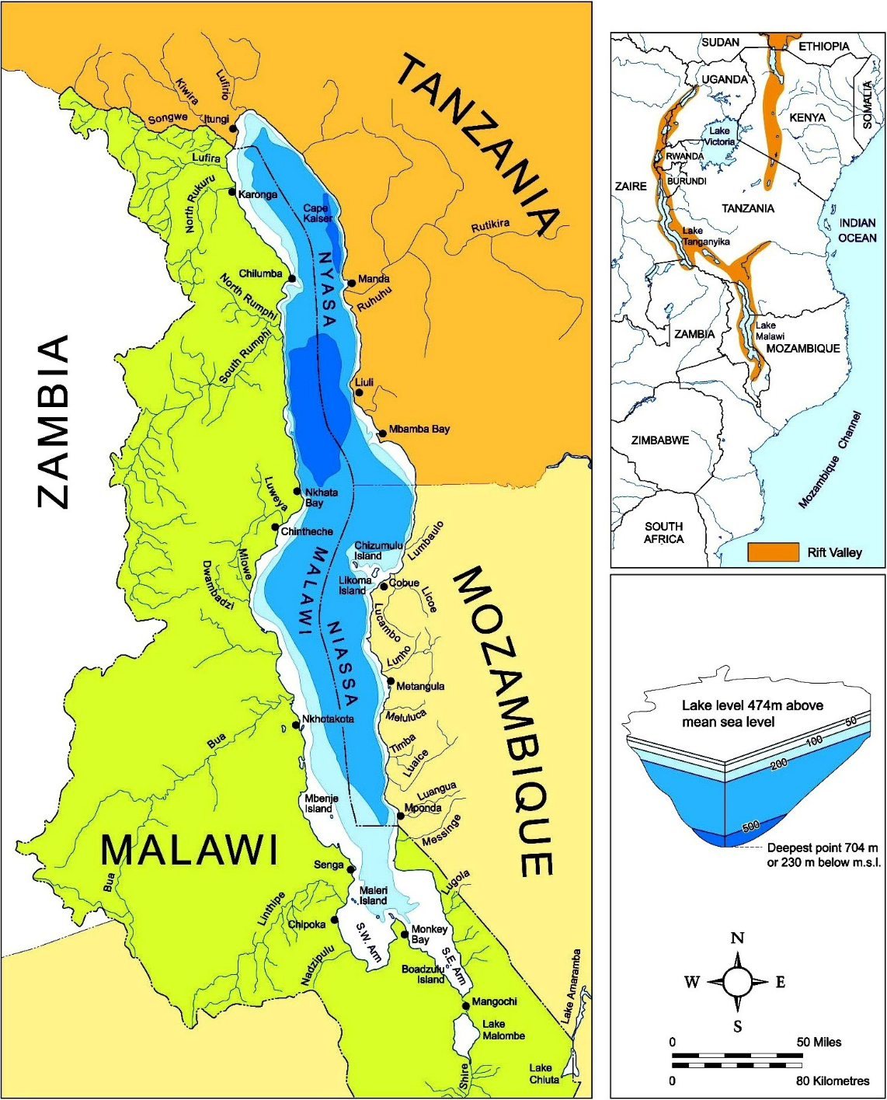
Overview of Lake Malawi/Niassa/Nyassa
Formed 5 to 10 million years ago.
The third largest lake in Africa, located at the southern end of the African lift valley at latitude of 9.5oS and 14.5oS and longitude of 34oE and 35oE.
Surface area = 29,500km2 Volume = 7,775km3 and a Maximum depth = 700m. Catchment exceeds 100,500 Km2.
Coastline mainly composed of rocky habitats, sandy beaches and vegetation of Phragmites
Over 15 major rivers drain into the lake

Slide 8
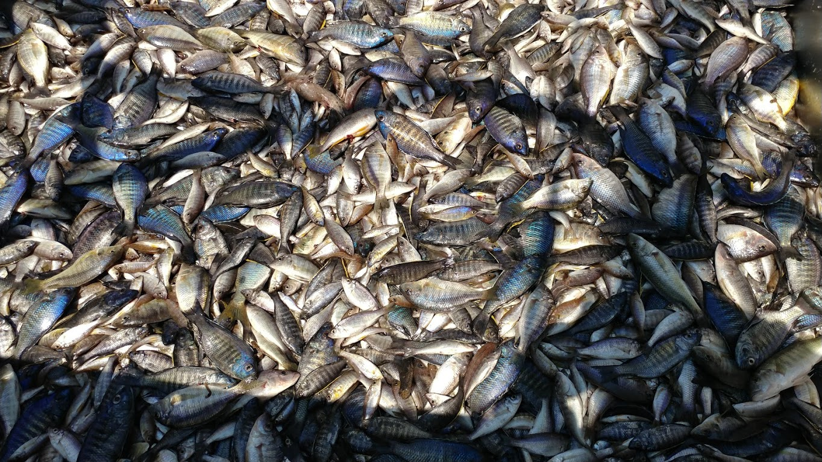
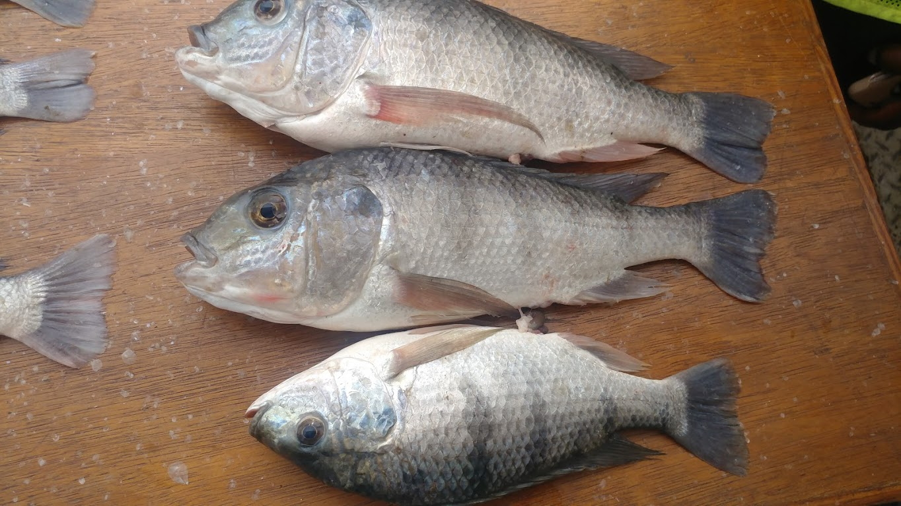
Ecological potential of the lake
Eleven families (11) with over 800 species, majority undescribed

Slide 9
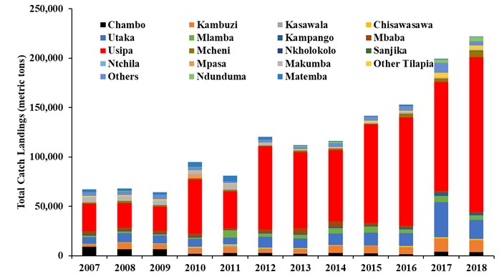
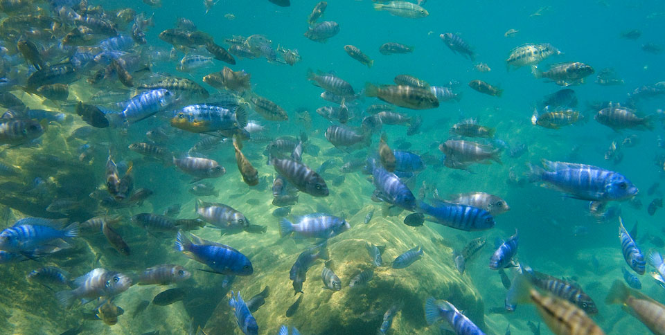
Status of the Fisheries
Over 200,000 tons is landed annually.
Medium to small species now dominate the landings
Usipa (Engraulicypris sardella) now exceeds 60% of total landings.
Shallow water fisheries (< 50 m deep) have collapsed
The ornamental fish trade has become a commercial business in recent years and exported to Europe, Asia and North America..

Slide 10
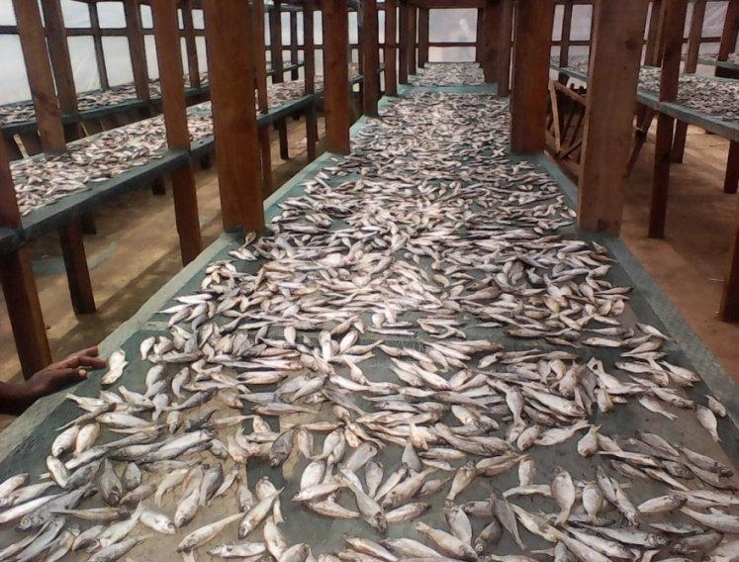
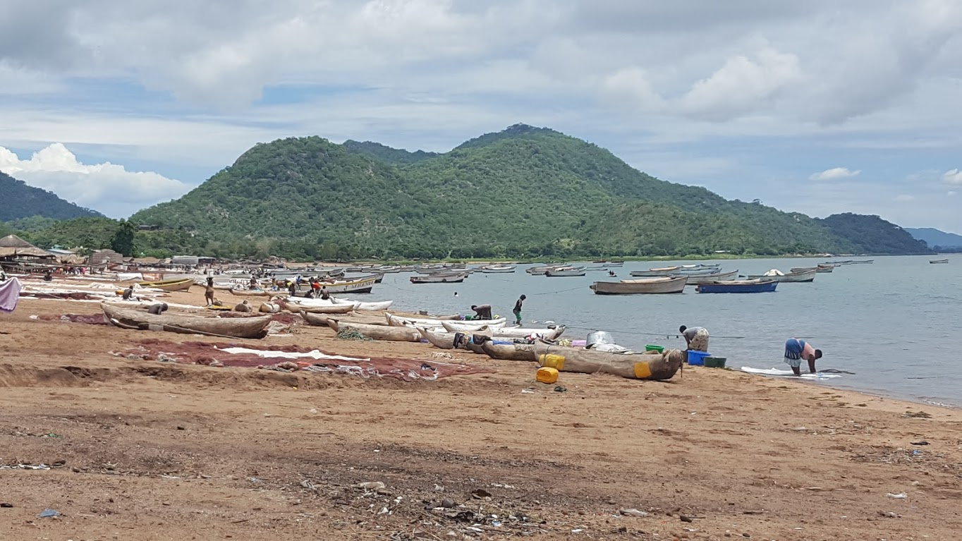
Socio-economic potential of the lake
The fisheries sector; (i) capture fisheries and (ii) aquaculture.
Capture fisheries includes small scale, large scale and ornamental fisheries.
The small-scale fisheries is “open access” and contributes over 90% of total landings. The Large scale and Ornamental fisheries are controlled through licensing and recently closed season.
The sector contributes significantly to the economy as a source of employment, food, income, export, and biodiversity.
Over 1.6 million people earn their livelihoods through fishing, fish processing, fish marketing, boat building and engine repair among others.

Slide 11
Advisory group purpose
To strengthen research to positively inform policy and management decisions to ensure the health of the lake’s resources
Networking on issues related to research, best management practices, and sustainabilitiy among the three riparian countries
To meet regularly so they can provide update on emerging issues
To provide inputs and make decisions for the organization without interference from external forces
To source funds through proposals for conducting joint research on Lake Malawi/Nyasa/Niassa

Slide 12
Milestones: Highlights and successes of 2020
12

Slide 13
Mozambique
Creation of a National advisory group to discuss issues related to Lake Niassa
So far 13 institutions including NGO’s and Public Institutions have adhered to this group

Slide 14
Malawi
Identification of stakeholders to be part of the National advisory group
So far twenty (23) names of individulas to be in the AG from Government institutions, Academia, Private Sector and NGO’s have been provided

Slide 15
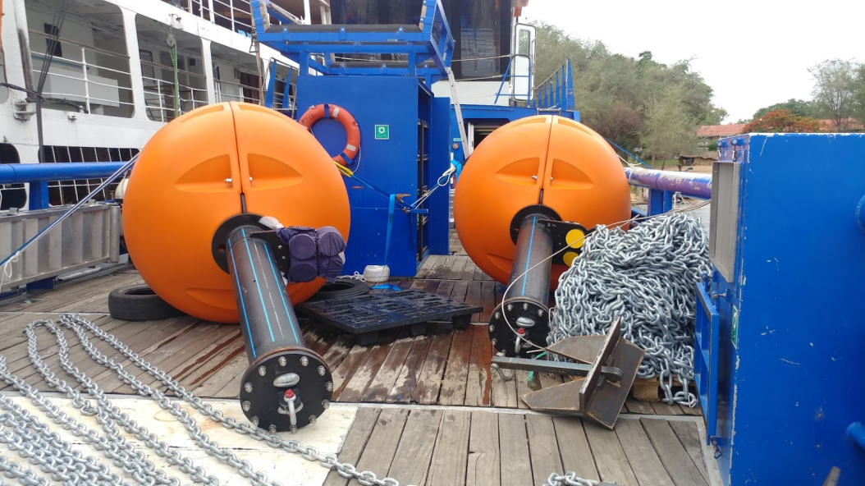
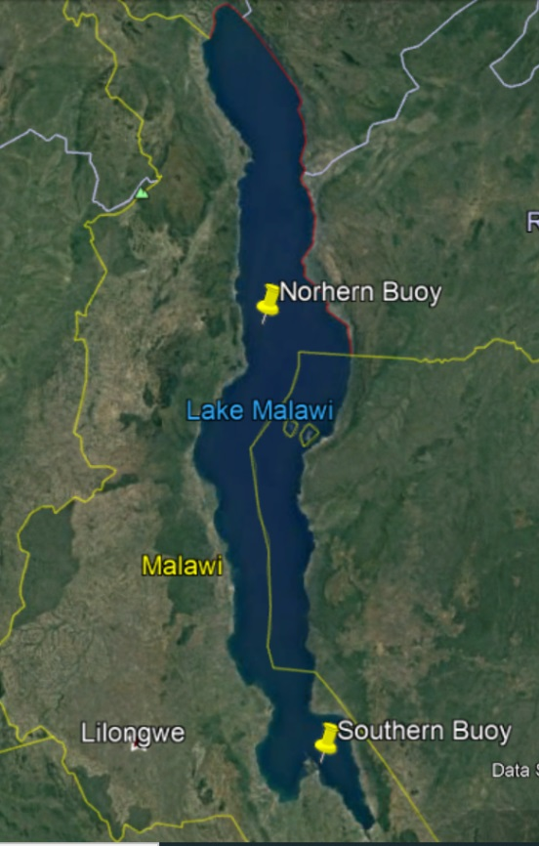
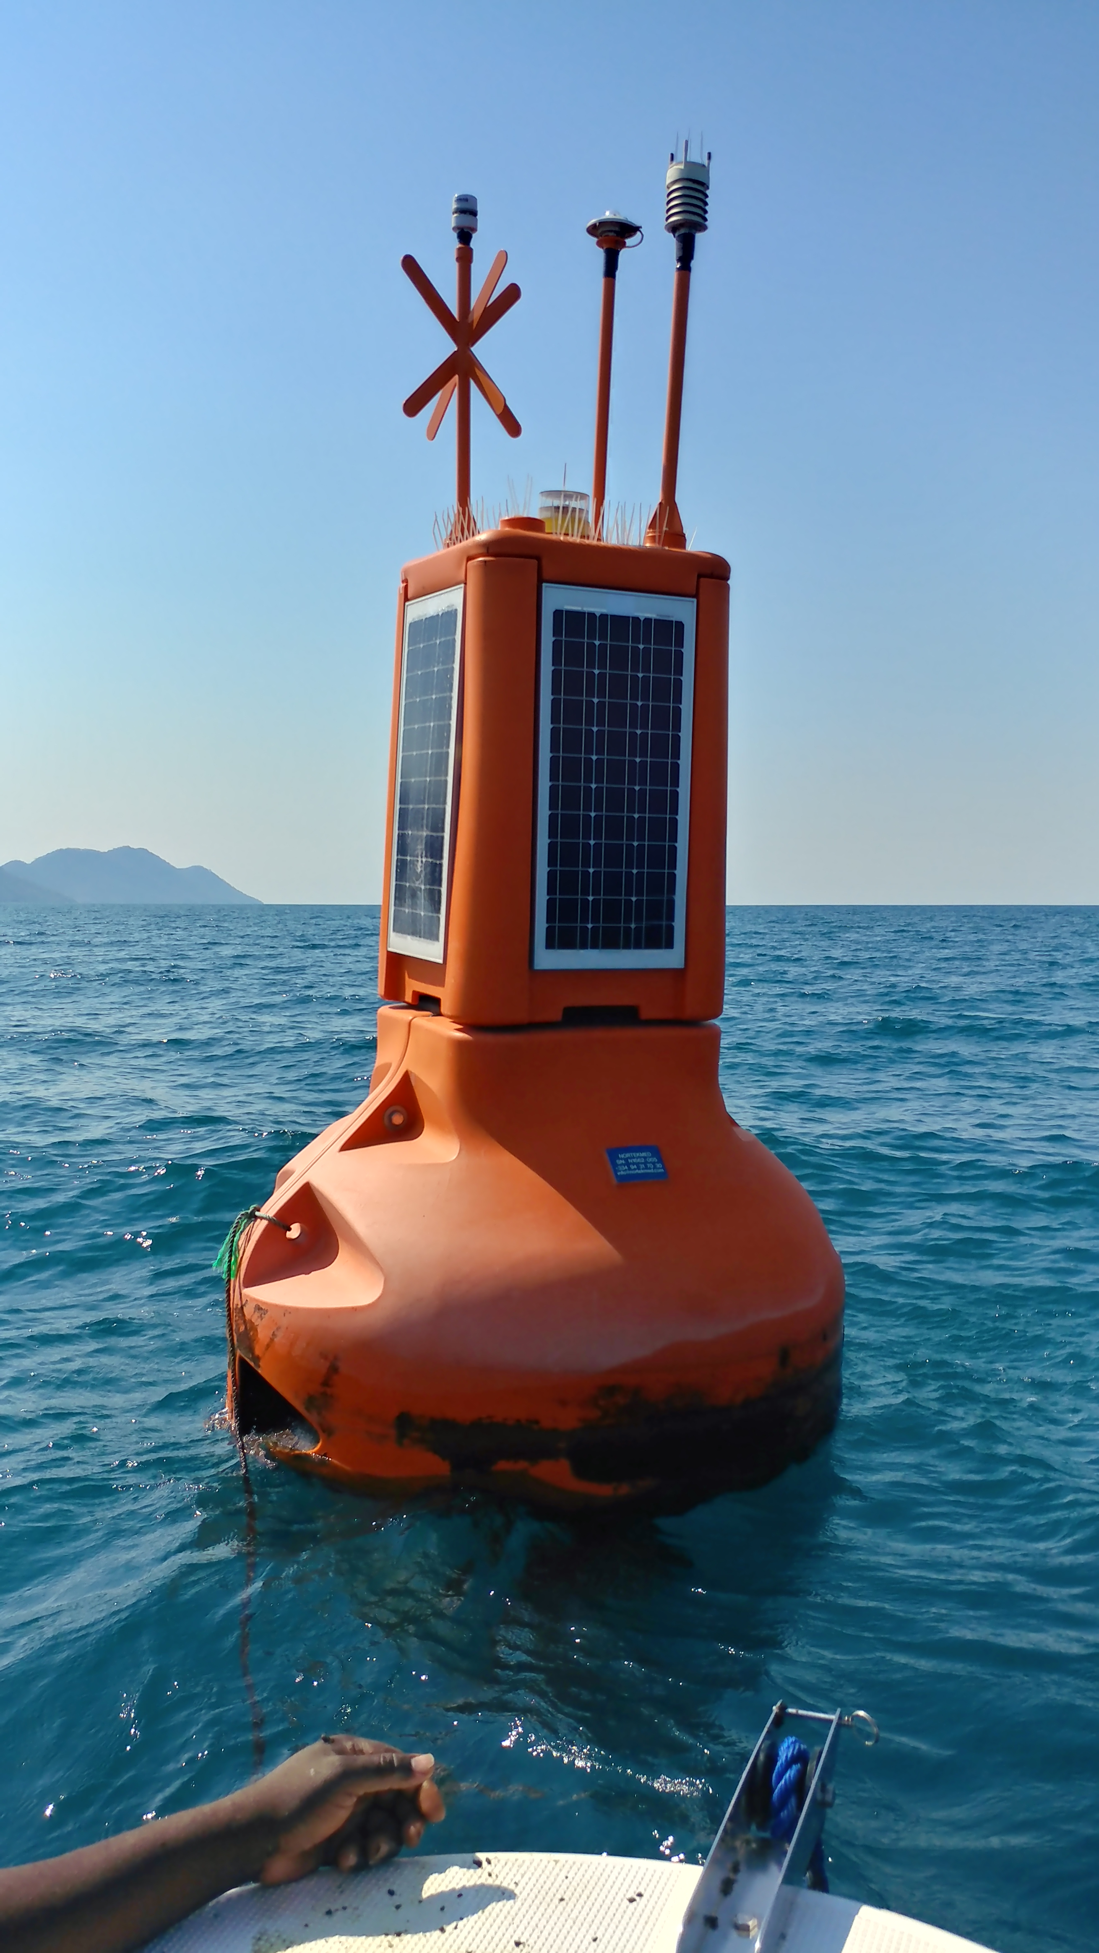
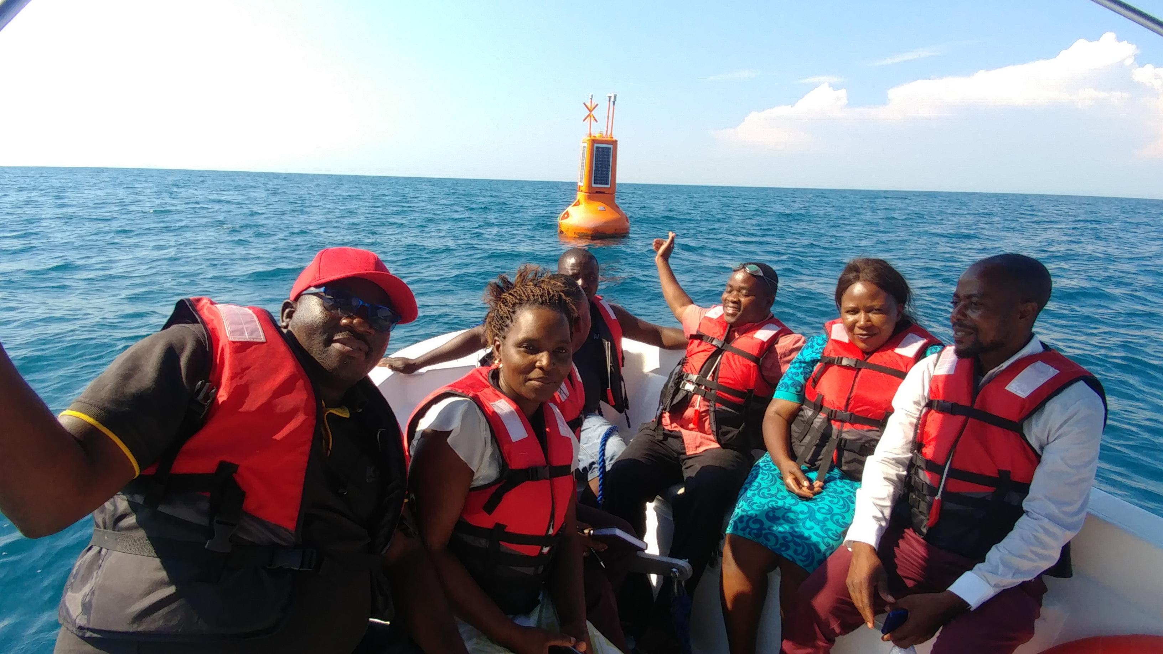
Installation of two Lake buoys on Lake Malawi

Slide 16
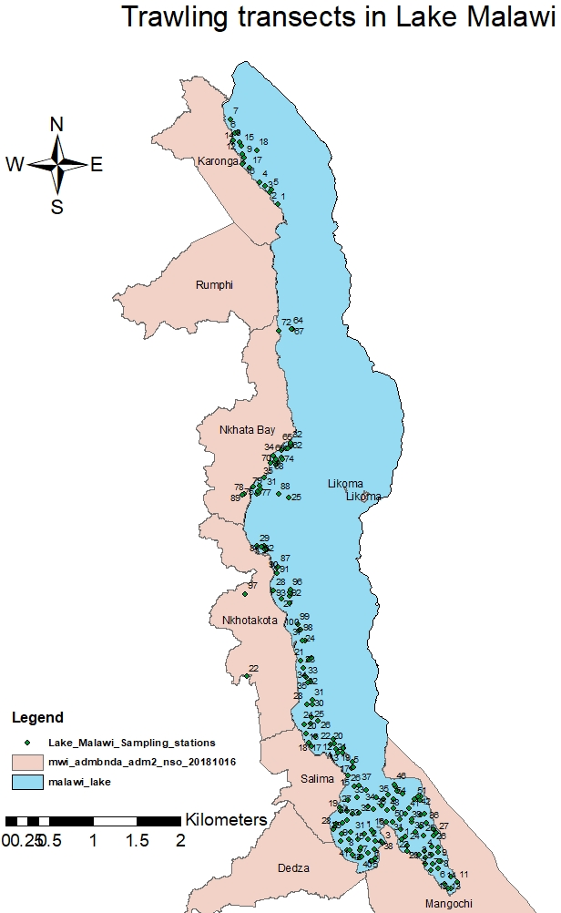
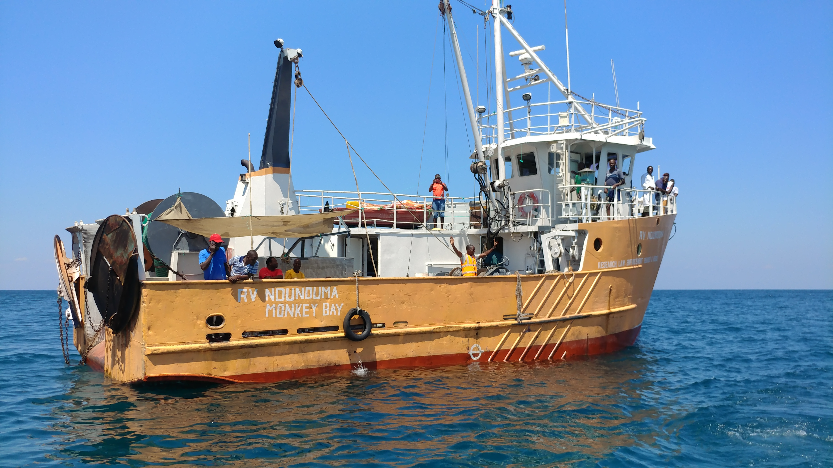
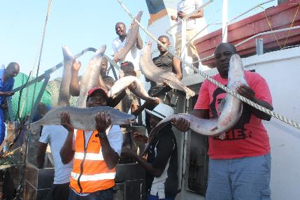
Biomass Assessment in Lake Malawi
Preliminary Results:
A total of 158 fish species from 46 genera and 6 families were recorded during the survey

Slide 17
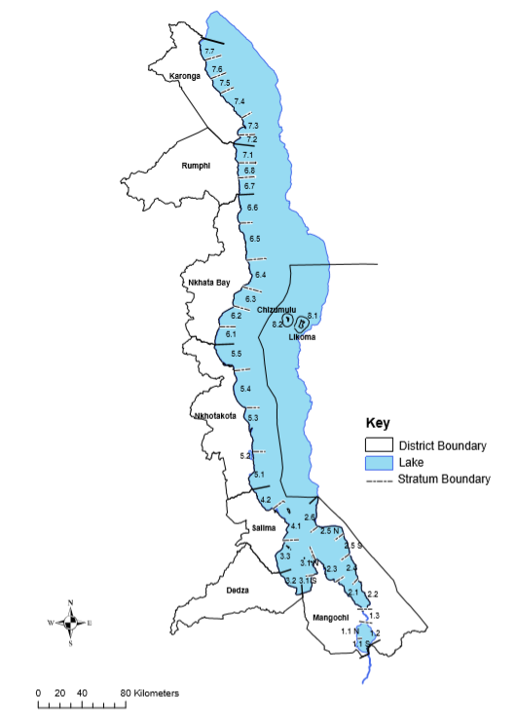
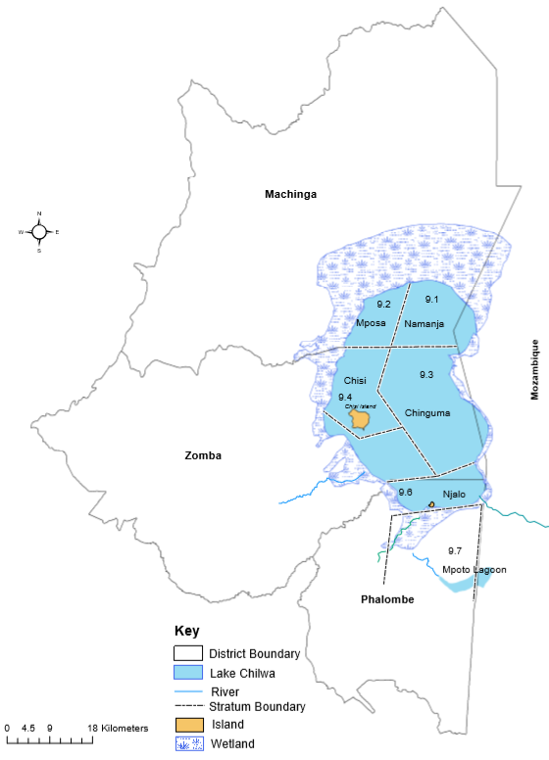
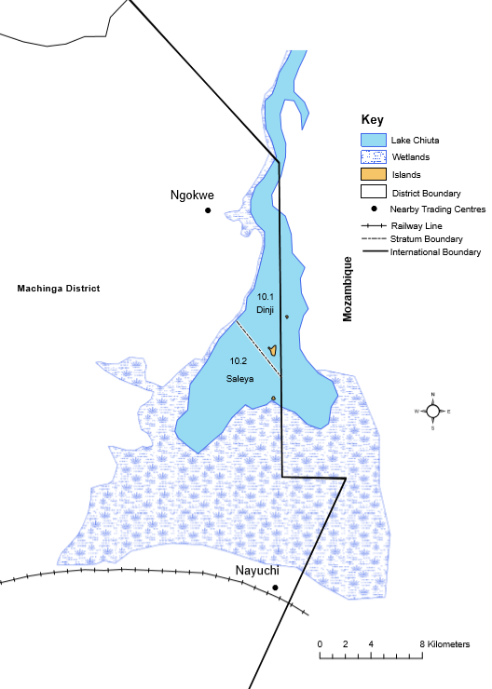
National Annual Frame Survey
Lakes Malawi and Malombe
Lake Chilwa
Lake Chiuta

Slide 18
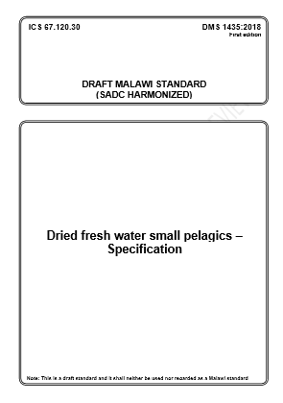
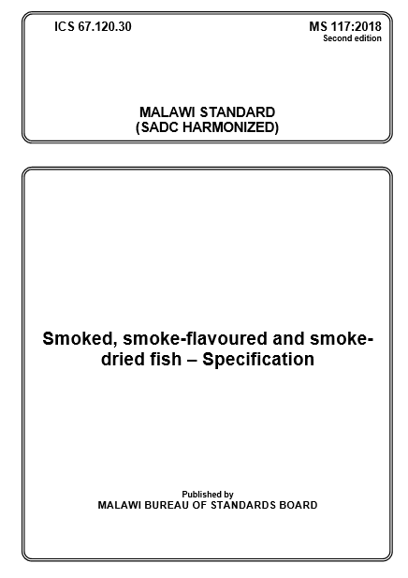
Review of fish standards

Slide 19
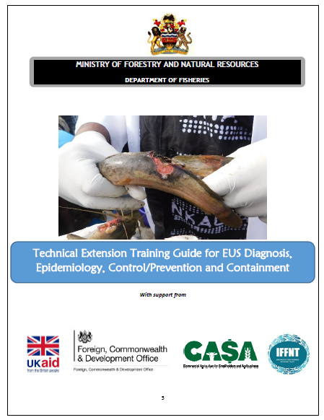
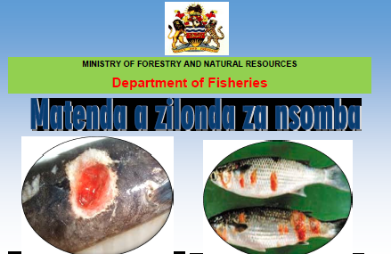
Development of EUS Containment Strategy and Capacity building towards the EUS Outbreak
3,000 posters and 5,000 brochures printed and distributed to communities by DFOs

Slide 20
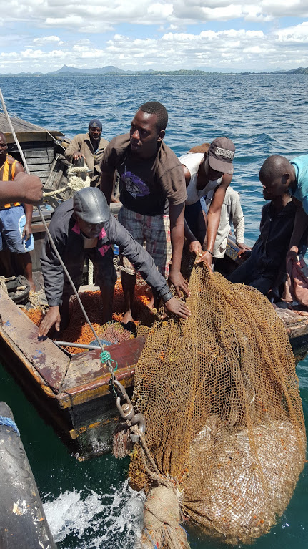
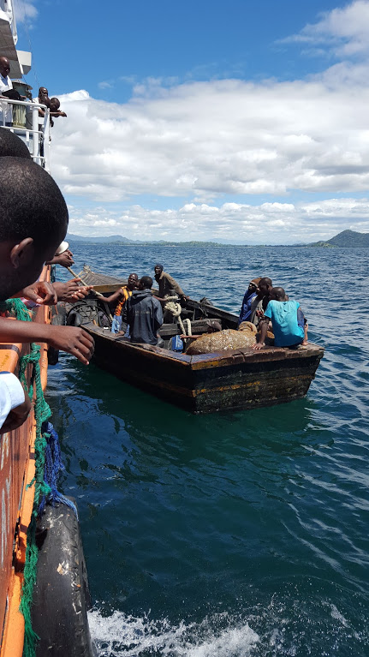
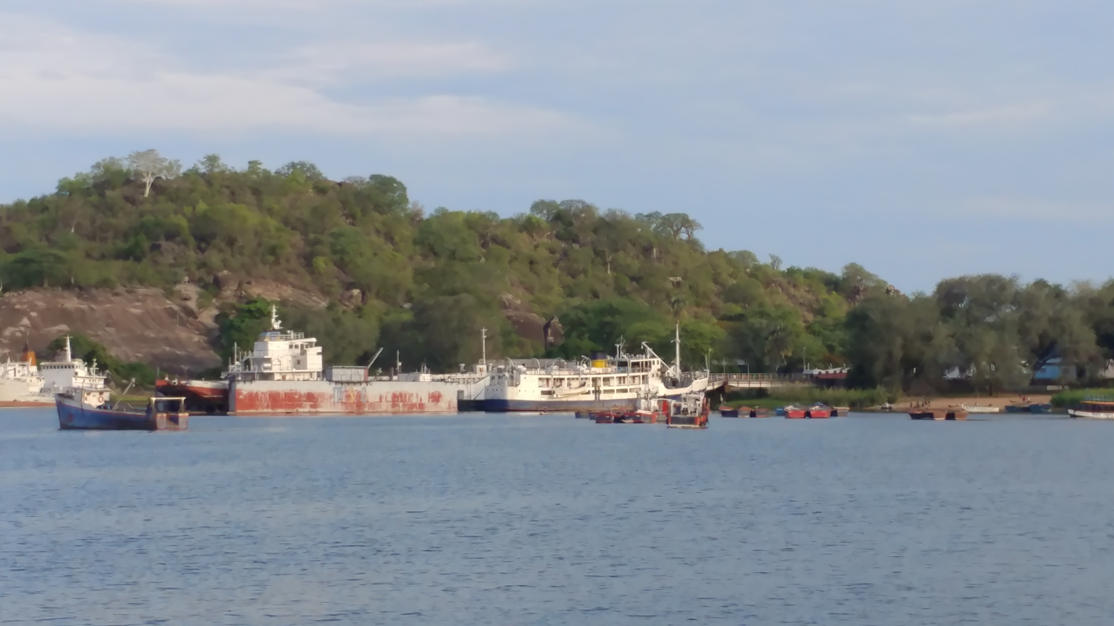
MONITORING OF LARGE SCALE COMMERCIAL FISHERY and IMPLEMENTATION OF CLOSED SEASON

Slide 21
Top Priority Research Areas
Fish stocks biodiversity assessment,
Fish biomass and fishing effort studies,
Aquaculture
Socio-economics,
Water quality,
Fisheries management and policy,
Endangered fish species,
Fish diseases and emerging issues

Slide 22
Roadmap (Plans-2021 and beyond, opportunities)
Set up the Advisory Group in Malawi and Tanzania
Institute a National Secretariat with financial support from ACARE
Compile and update all existing information related to research, socio-economics, institutions, legislation, fisheries management and discuss priorities to leverage sustainable development in Lake Malawi/Nyasa/Niassa basin
Hold 2 meetings with the Advisory Group for Lake Malawi/Nyasa/Niassa

Slide 23
Best resource investment for this lake/group
Conduct studies to describe the roles, relationships, strategies and challenges of the various groups of stakeholders in Lake Malawi/Nyasa/Niassa.

Slide 24
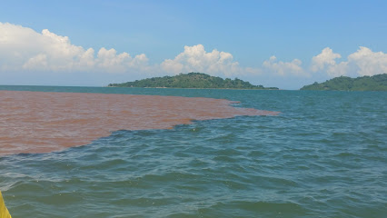
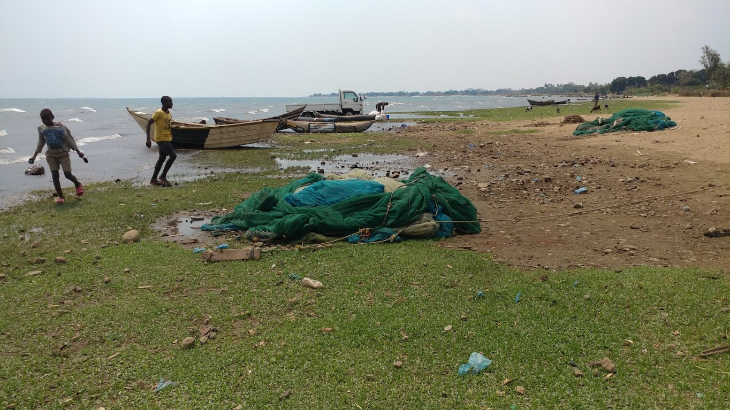
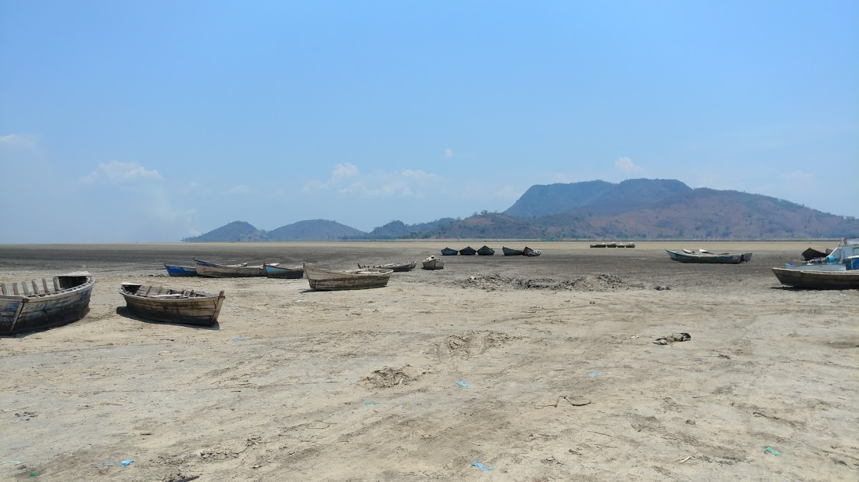
Siltation
Some challenges for Lake Malawi/Nyasa/Niassa
Plume from Linthipe River
Drought
Drying up of Lake Chilwa
Overfishing
Use of illegal gears

Slide 25

Thank you
www.agl-acare.org
Notes:
25

