Slide 1




2020 Annual Conference of the African Great Lakes Stakeholders Network:
Lake Kivu Advisory Group
Fabrice Muvundja, Professor, Institut Supérieur Pédagogique de Bukavu, D R Congo
Building the Foundation for Long-Term Scientific Inquiry and Networks
December 10th, Virtual
Notes:
1

Slide 2
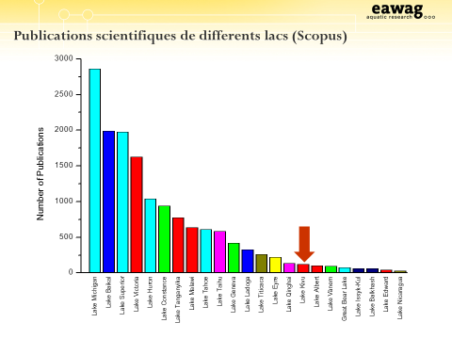
Why an Advisory Group for Lake Kivu?
Because:
the lake is poorly known
the lake is poorly managed
Environmental threats are exponentially increasing
there is a need of a sustainable management of the lake to be guaranted by research, education, good policy and regulations
Schmid (2013)
Schmid M., 2013

Slide 3
Purpose of the Group
Main purpose:
to enhance research and education about Lake Kivu as well as the communication and collaboration between entities across borders and sectors for the well being of the riparian communities

Slide 4
Specific objectives
Standardization of research protocols
Identify lacking information and (knowledge) gaps
Build technical capacity and acquire research facilities
Educate and train human resources and communities
Act as a frame to promote research and education (project proposals, fundraising …)
Sharing data on a common platform and dissemination

Slide 5
Specific purposes (contin’d)
-Make recommendations for policy making
Enhancing research mobility and to share experience between other lakes (and advisory groups) of the World.
Facilitate knowledge and transfer new technology to the riparian communities/Research oriented towards the needs of the community
Understand and get inspiration from valuable traditional knowledge of the local communities

Slide 6
Group membership
Group composition (27 institutions identified):
Members from research centers and institutions of higher Eduction dealing with Fisheries and aquatic sciences worldwide (priority 1)
Members nominated by Governmental agencies dealing with environmental questions, water and sanitation, fisheries, lacustrine transport) (priority 2 and 3)
Fishermen cooperatives (priority 2), civil society(priority 3)
Members nominated by Methane extraction companies (priority 2) and marine forces (priority 3)
…both working in DRC and Rwanda

Slide 7
Group leadership
Coordinator
Deputy Coord. of research
Deputy coord. of administration and finance
Communication and external relations Officer
Secretary
Deputy Secretary

Slide 8
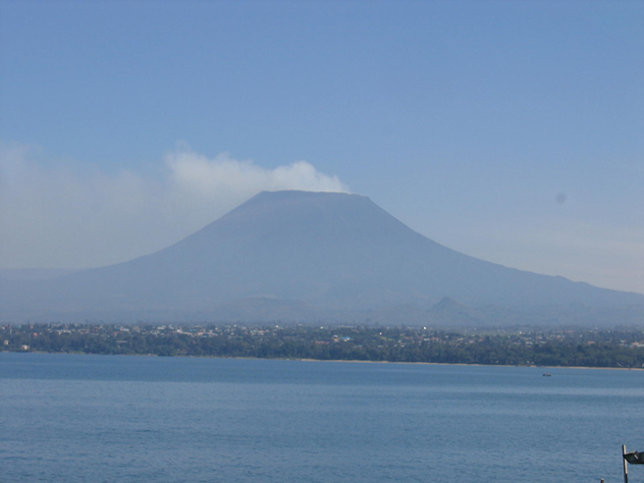
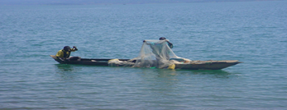
Lake Kivu overview

Slide 9
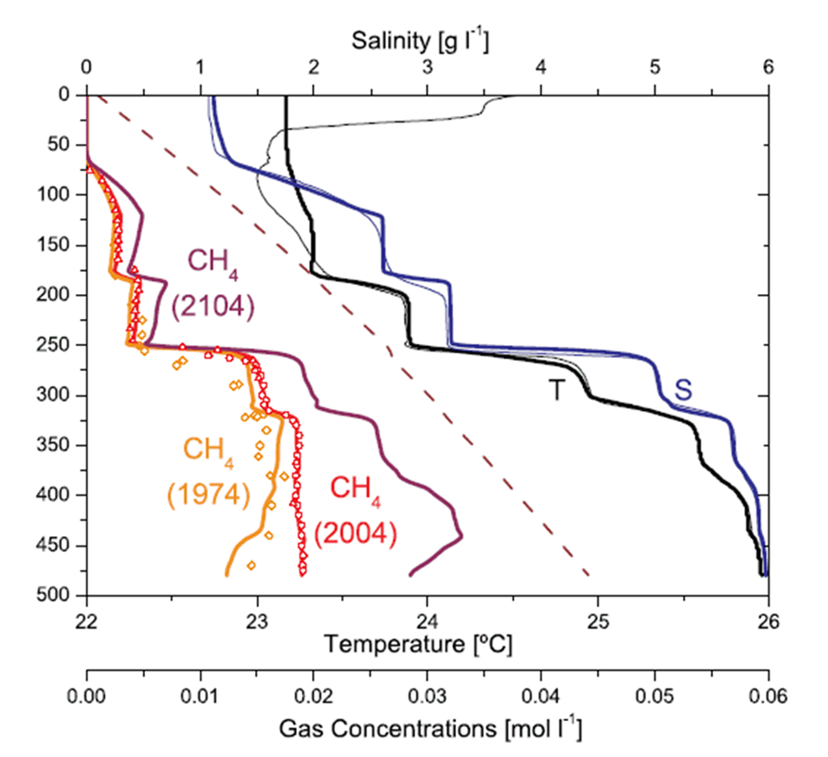
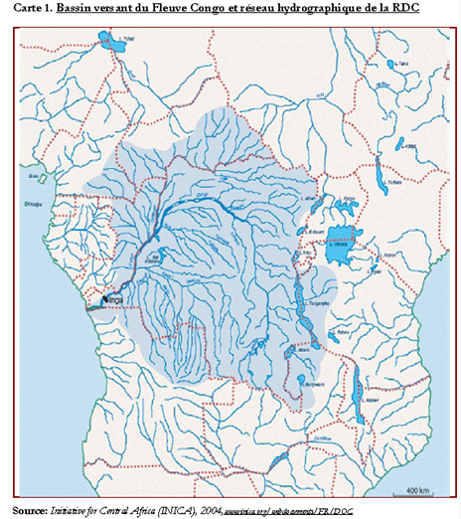
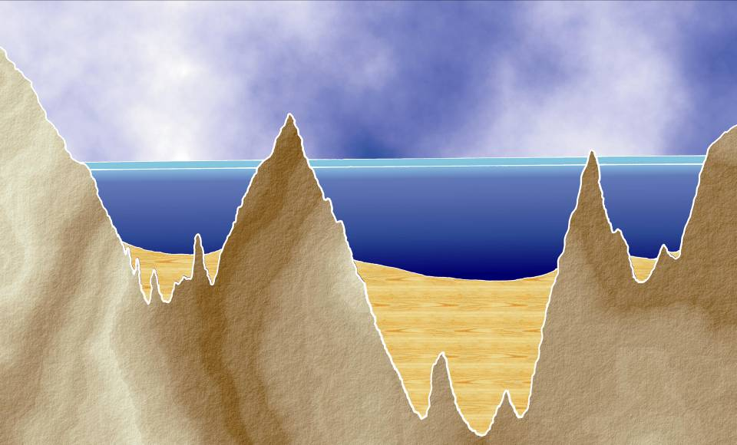
Geographical location and main patterns
Meromictic lake located in the Congo basin between Rwanda and DR Congo
« mixolimnion"
Rwanda
Idjwi island
D R Congo
hypolimnion
~ 492 m
~ 500 m

Slide 10
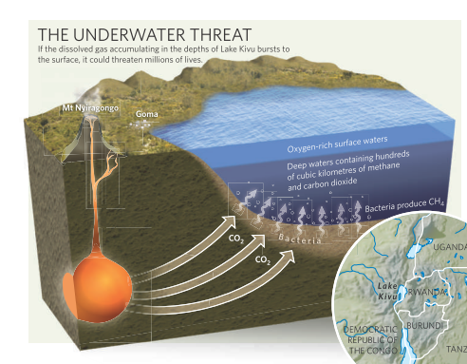
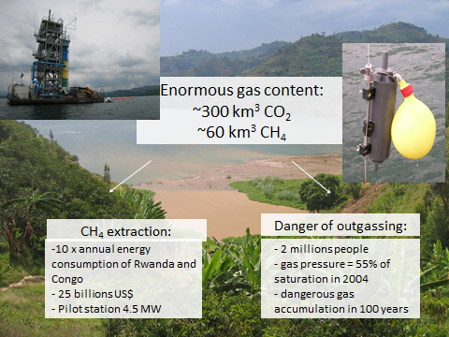
Resources
Methane reservoir
Nature (2009)
Pasche (2010)
Methane exploitation has started at the Rwandan side (e.g. Kivuwatt, find more at https://www.youtube.com/watch?v=1ZA5PaB36v8)

Slide 11
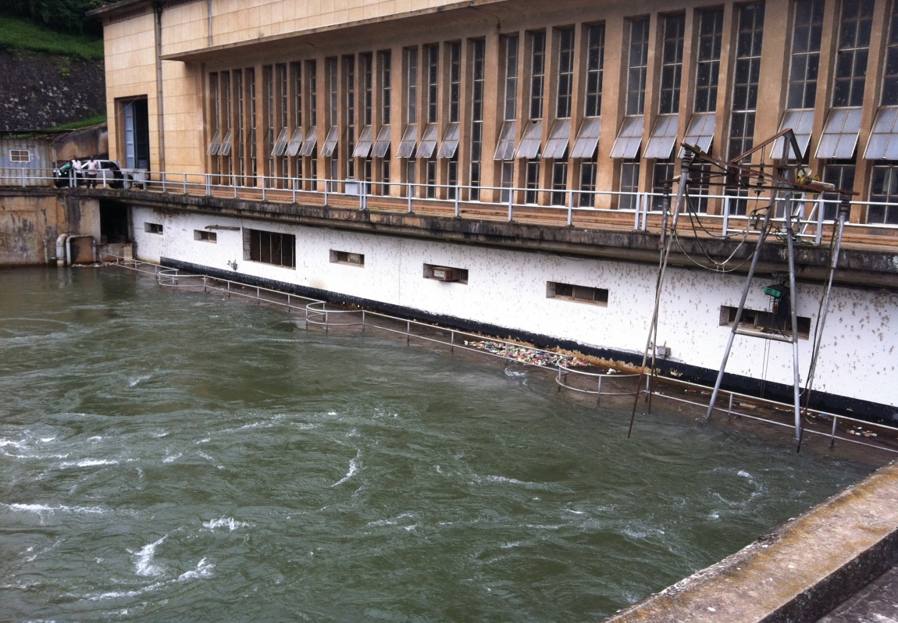
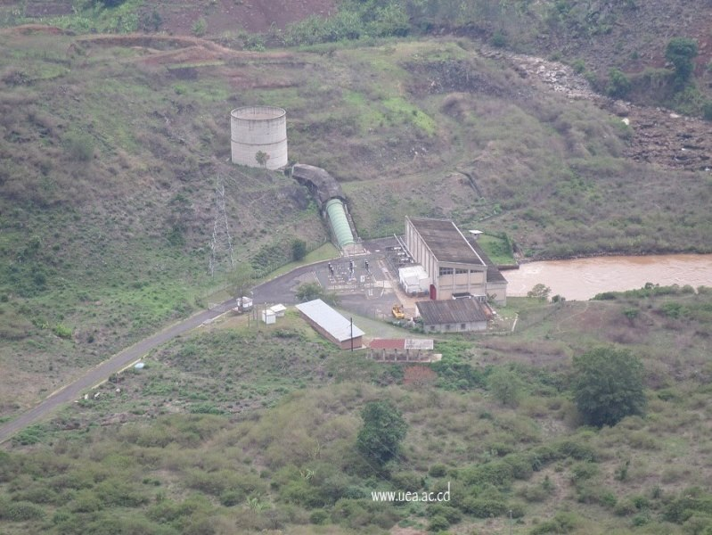
Hydropower Energy
Two HP plants are operational and two others are planned at Ruzizi river, outflow of Lake Kivu for the energy supply of DR Congo, Rwanda and Burundi
Ruzizi I HP dam 28 MW)
Ruzizi II HP dam (44 MW)

Slide 12
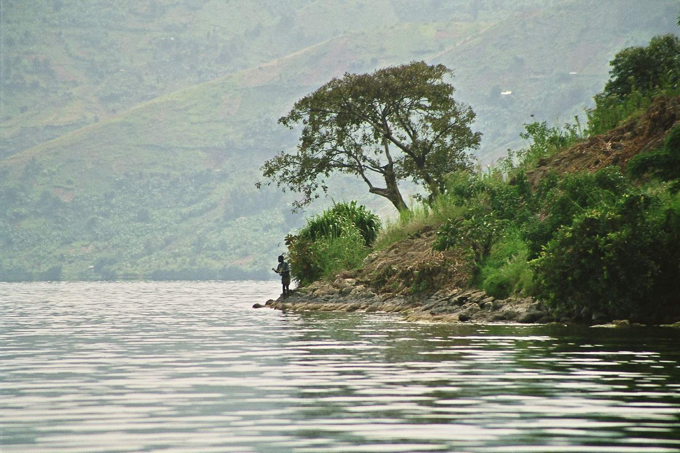
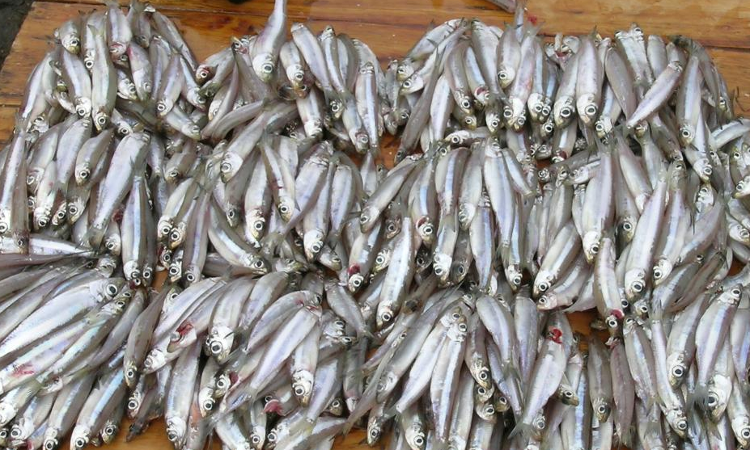

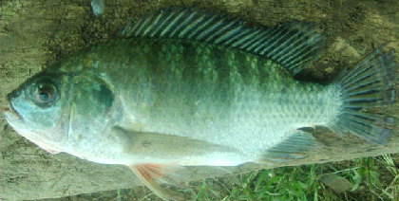
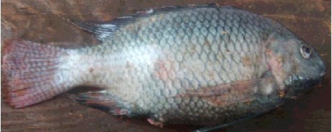
Fisheries resources
Lake Kivu fishery is dominated by the exploitation of the Tanganyika sardine, Limnothrissa miodon introduced in 1959
28 other fish species exist but with minor fishery importance
Lamprichthys tanganicanus00
T. rendalli
O. macrochir
Notes:
12

Slide 13
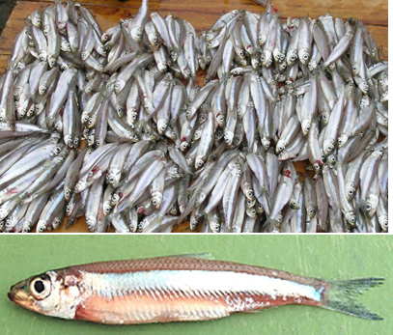
Lake Kivu
-Exploitable fish stock is between 5 et 6000 tons p.a. (1/5 of that of Lake Tanganyika): ~12 millions USD
-Mean density between 15 and 40 kg.ha⁻¹
(Guillard, Darchambeau, Masilya et Descy, J.Great Lakes Research, 2012)
Notes:
13

Slide 14
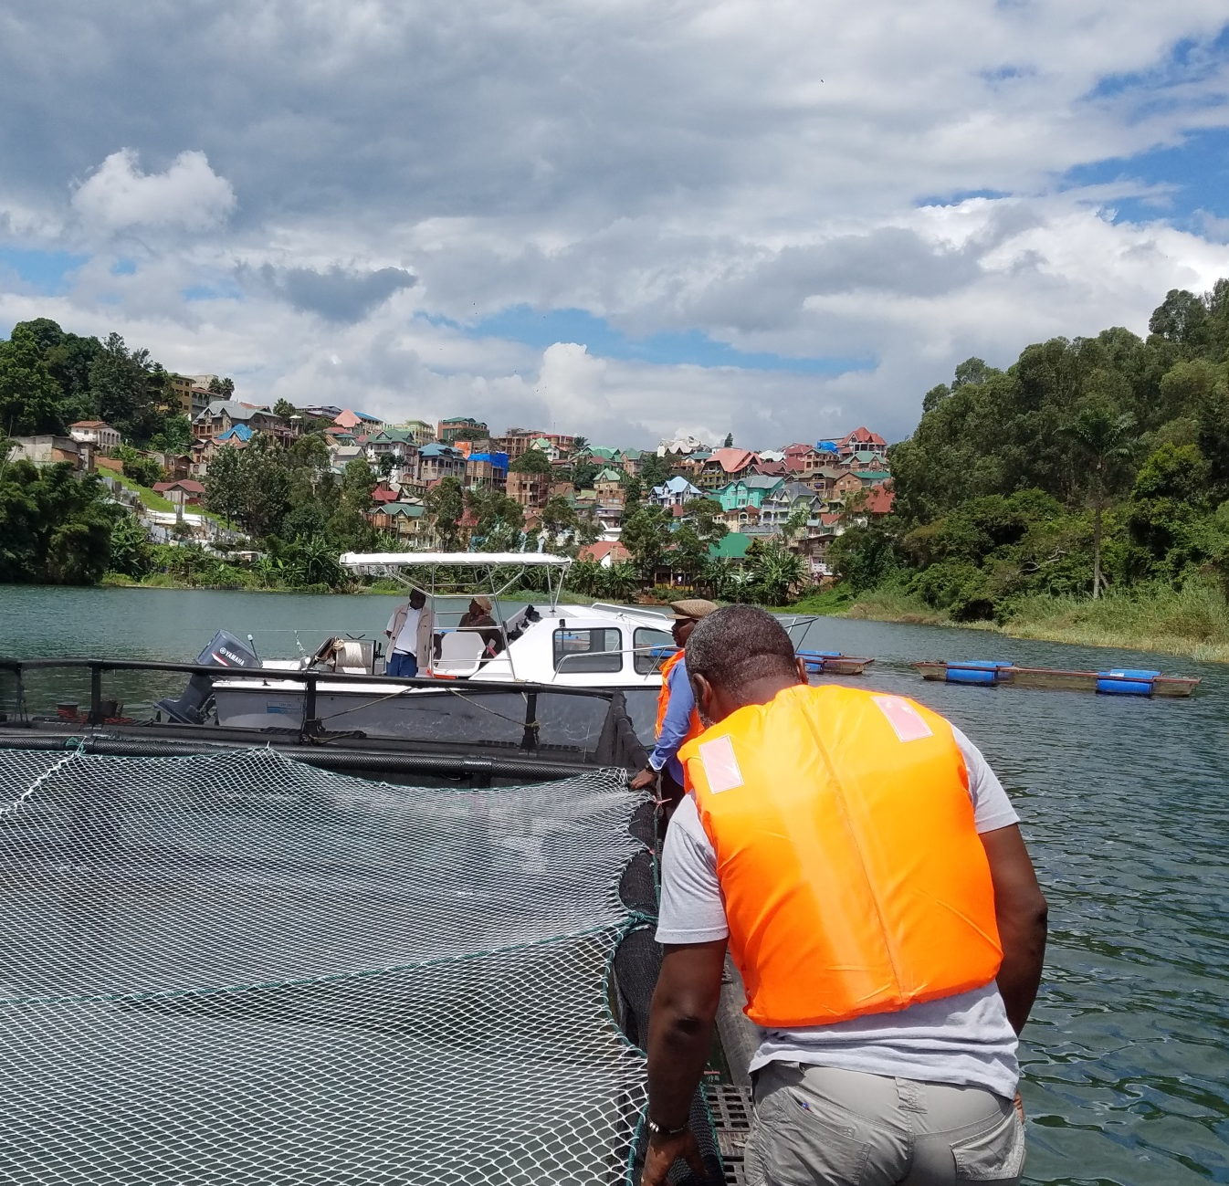
Aquaculture potentiel
Although aquaculture is still at its young age on Lake Kivu, the sector is starting to grow both in Rwanda and DR Congo.

Slide 15
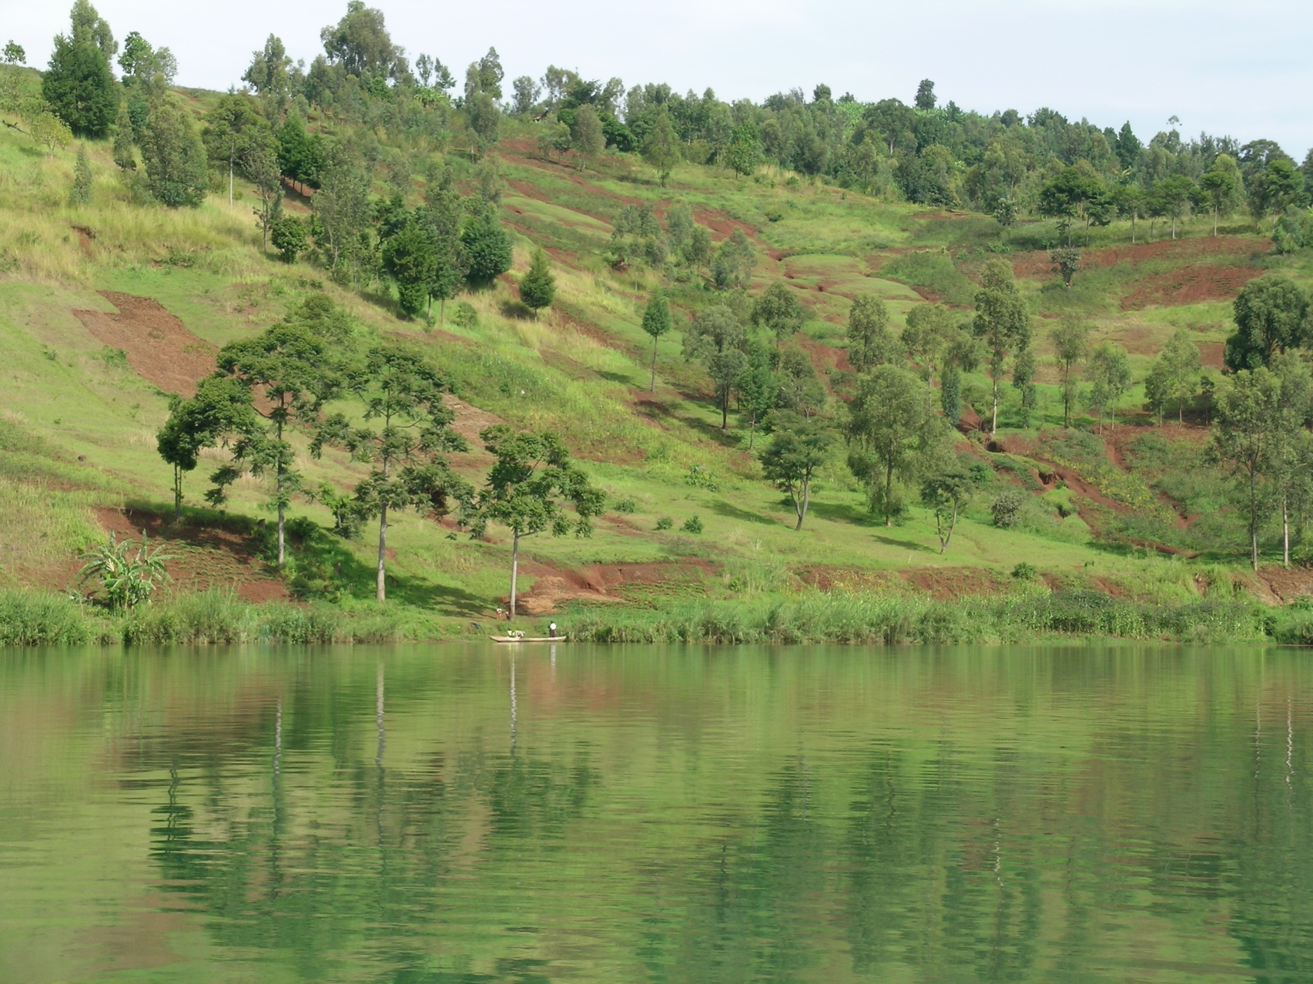
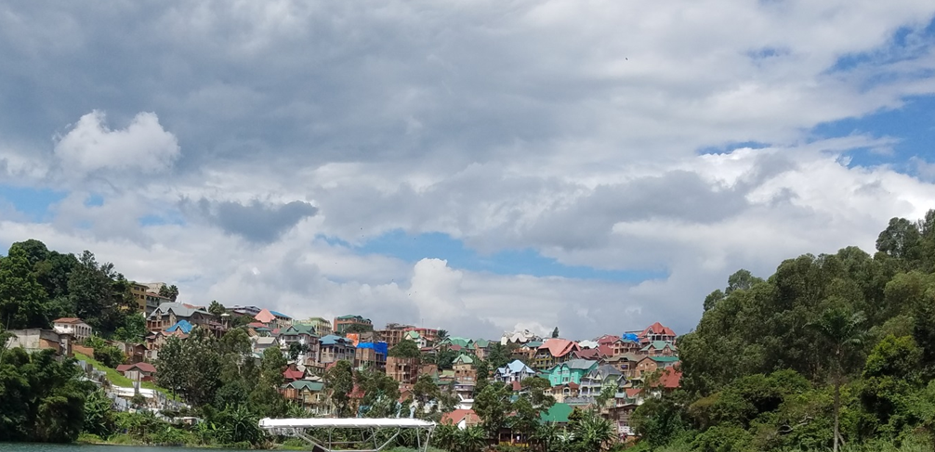
Other resources:
Water resource to riparian towns (e.g. Goma)
Transport between Goma, Idwi, Kalehe and Bukavu
Research and education
non-tangible resources: Tourismn sports and recreation, fresh microclimate, culture preservation, etc.
Notes:
15

Slide 16
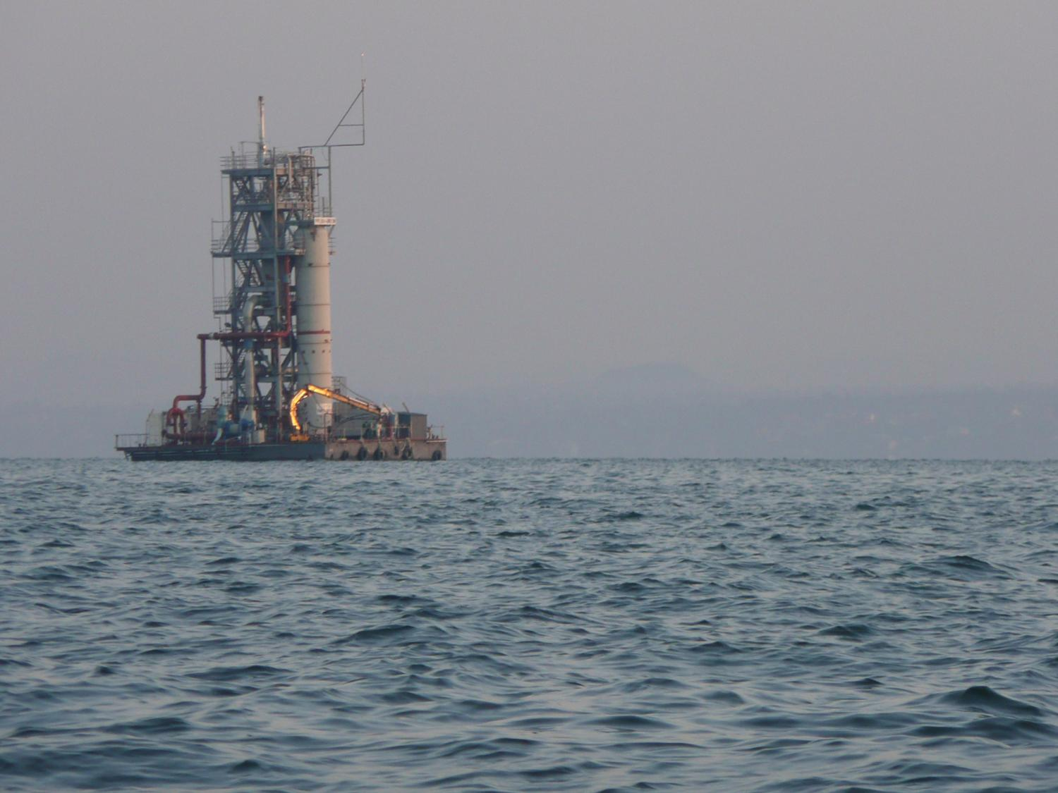
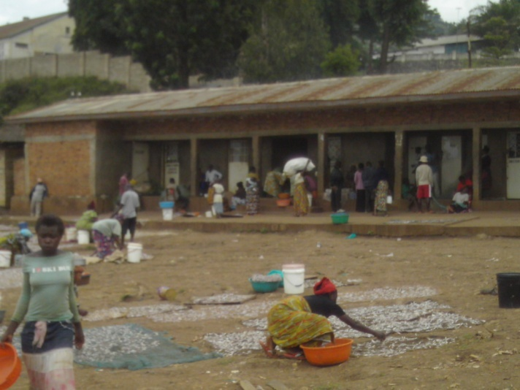
Challenges to the Lake sustainable management
Lack of sufficient knowledge
Poor management (illegal fishing)
Pollution, habitat destruction and degradation
Lack of environmental awareness
Lack of management concertation
among riparian countries
Poverty among the riparian populations
and fishermen communities
Land and resource degradation in the catchment

Slide 17
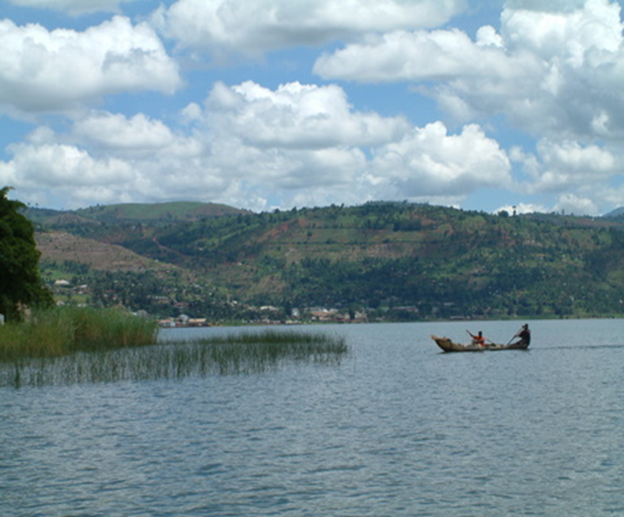
Capacity building of the lake management stakeholders (fishermen and aquaculture cooperatives, fisheries officers and local governments, fisheries education sector, etc
Review and update of fisheries and aquaculture policies and regulations
Elaboration of strategic development plans for local governments
Harmonization of fisheries and aquaculture management tools between Rwanda and Congo for Lake Kivu

Slide 18
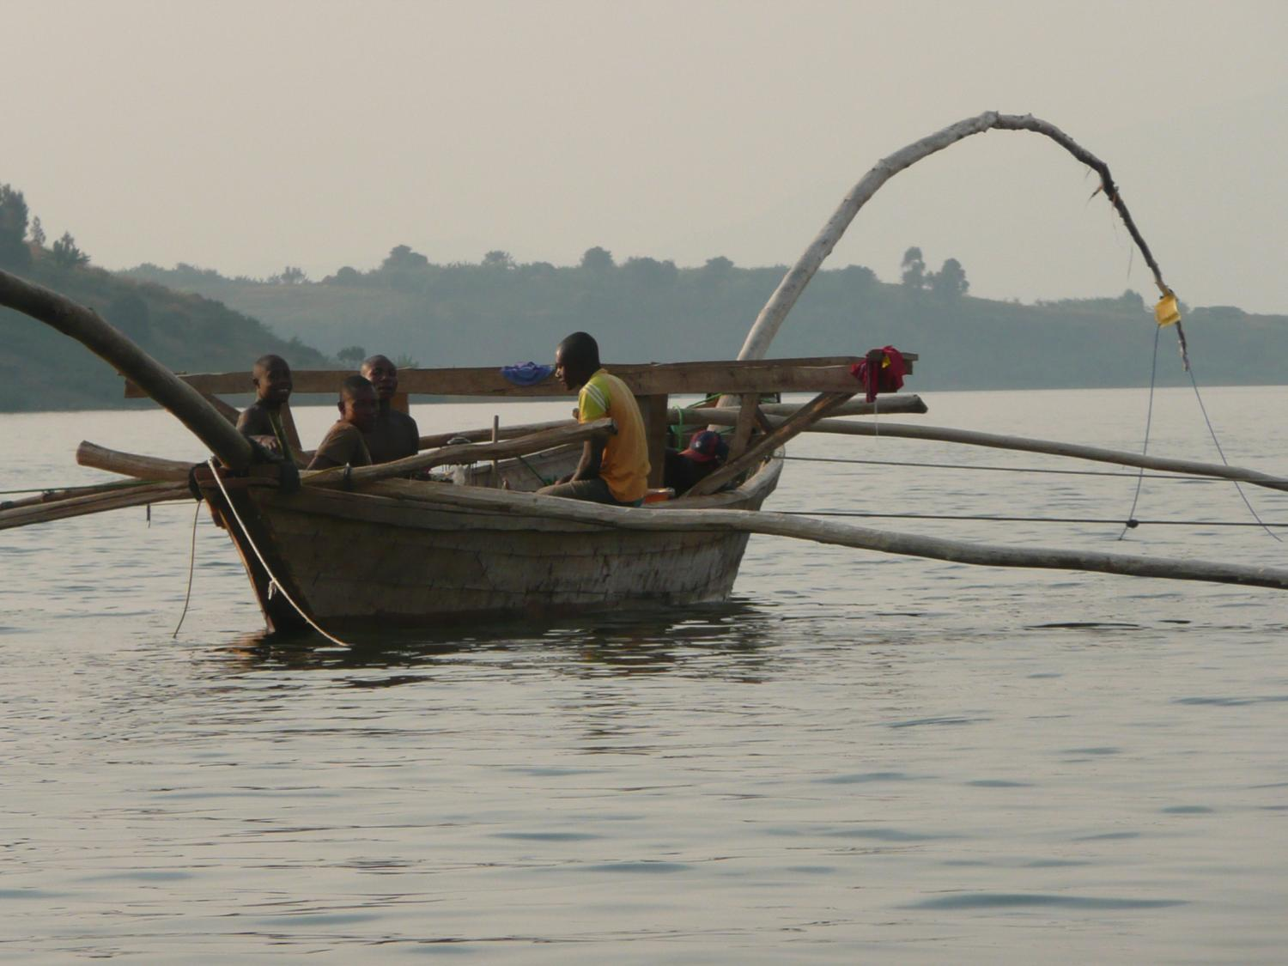

Invasive species prevention
Fisheries and aquaculture value chain development
Security and safety ensurance on the lake
Notes:
18

Slide 19

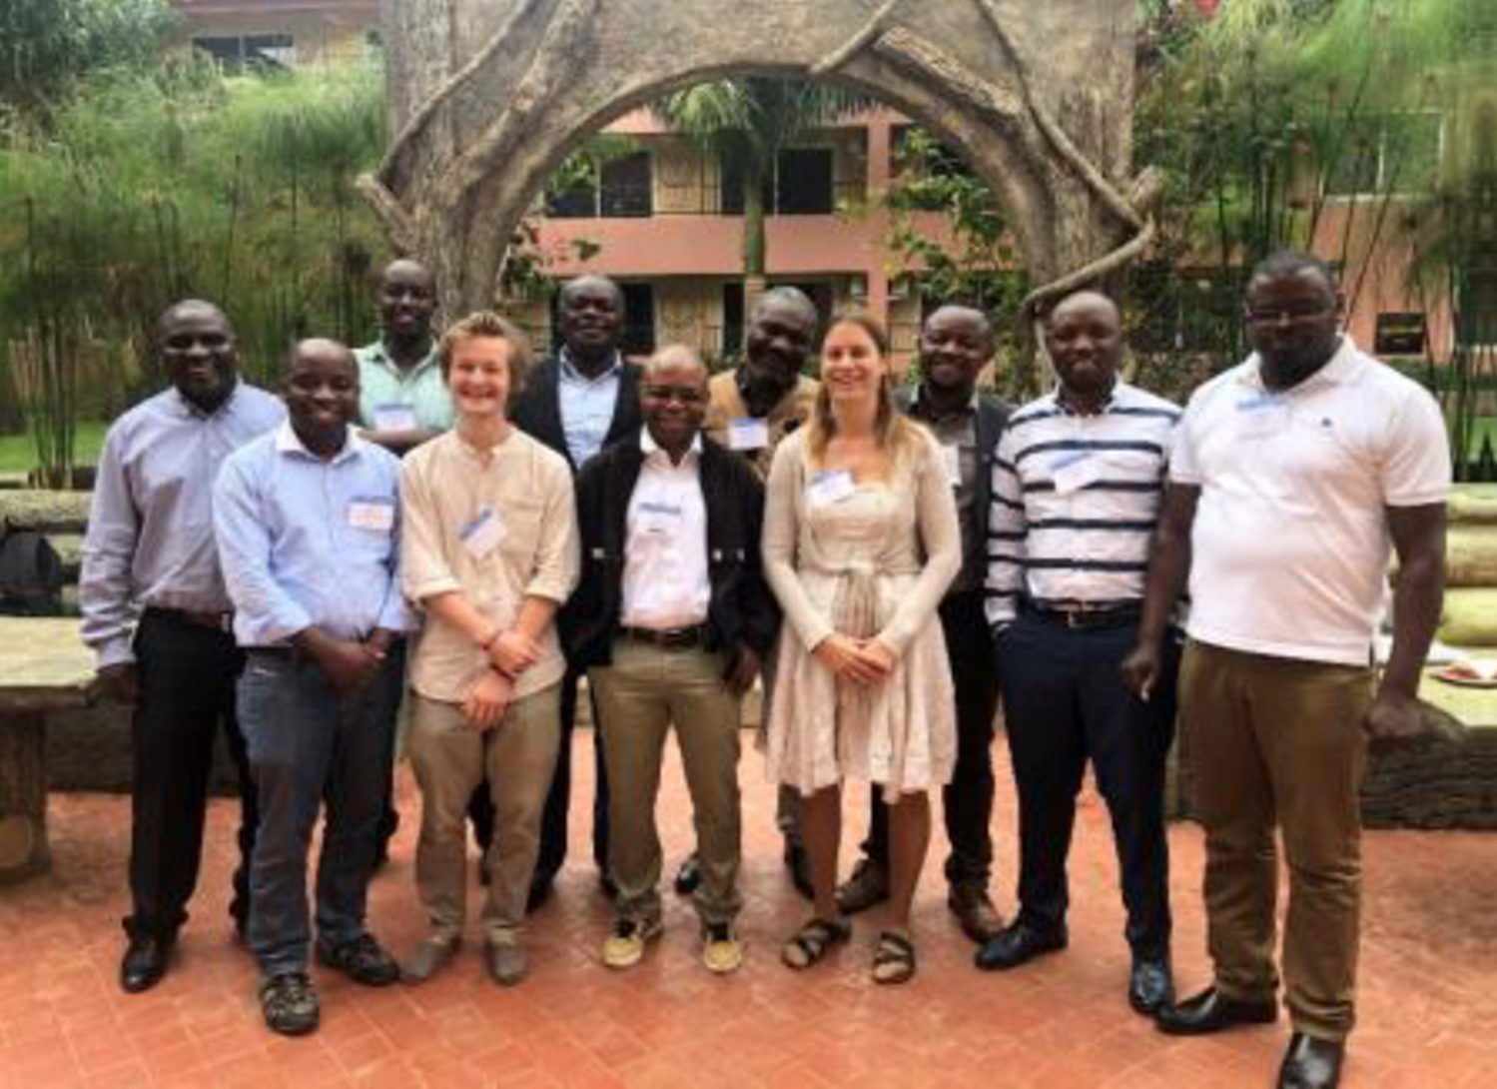
Prof. Muvundja Fabrice
Prof. Isumbisho Pascal
Prof. Masilya Pascal
Dr. Akonkwa Balagizi
Dr. Kisekelwa TChalondawa.
Dr. Balagizi Charles
Dr. Natacha Pasche
Prof Rukeratabaro Simon
Mr. Nahayo Déo
Mr. Rugema Edouard.
Mr. Ruhana Eric
Thank you
www.agl-acare.org
Notes:
19

