Slide 1
2020 Annual Conference of the African Great Lakes Stakeholders Network:
Lake Tanganyika-Science Advisory Group
Ismael Kimirei, LT-SAG Lead, TAFIRI
Building the Foundation for Long-Term Scientific Inquiry and Networks
December 10th, Virtual
Notes:
1

Slide 2
LT-SAG Team Members
Ms. Beatrice Marwa (LTA); Dr. Claver Sibomana PhD (BUR); Prof. Gaspard Ntakimazi (UB); Prof. David Nahimana (BUR)
Dr. Nshombo Muderhwa (DRC); Prof. Pascal Masilya (DRC); Prof. Pascal Mwapu Isumbisho (DRC); Deo Mushagalusa (DRC)
Prof. Cyprian Katongo (ZAM); Dr. Harris Phiri (ZAM); Dr. Lloyd Haambiya (ZAM– CO-LEAD);
Dr. Ismael Kimirei (TZ – LEAD);Mr. Huruma Mgana (TZ); Ms. Ritha Mlingi (TZ); Mr. Peter Limbu (TNC Tuungane Program)
Dr. Els Dekeyser (BE)
2

Slide 3
Riparian Countries | Burundi, DR Congo, Tanzania & Zambia
Altitude (surface) | 773 m
Surface area | 32,600 km²
Volume | 18,880 km³
Maximum depth | 1,470 m
Average depth | 570 m
Length | 670 km
Width | 50 km
Flushing time | 7,000 years
Residence time | 440 years
Drainage area | 232,000 km²
Population | 10 million
Age | 12 – 20 m yrs
Diverse organisms | > 1500
Endemism | ≈ 70%

Slide 4
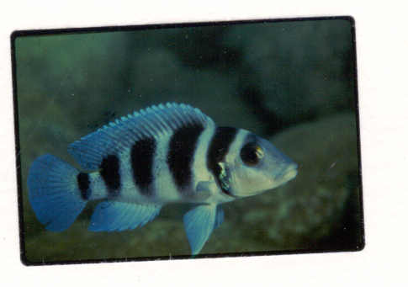
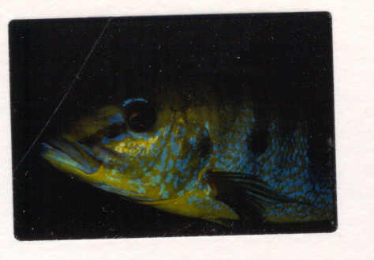
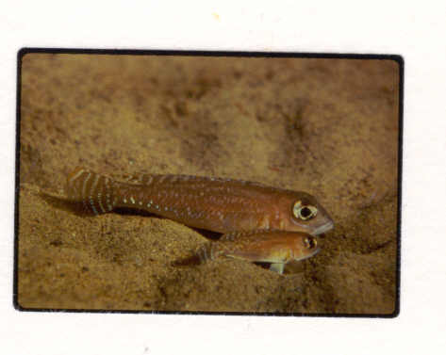
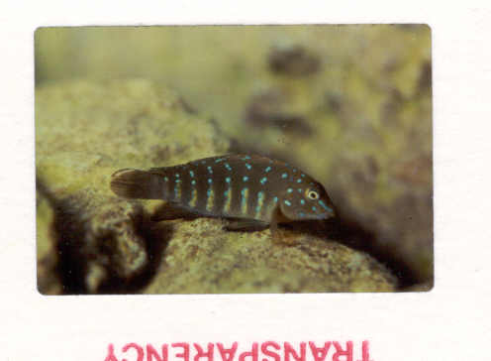
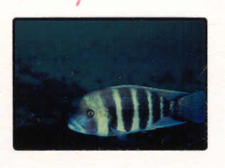
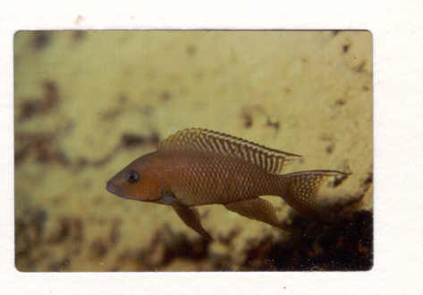
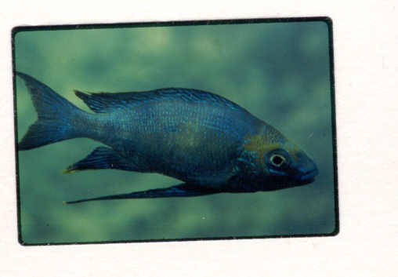
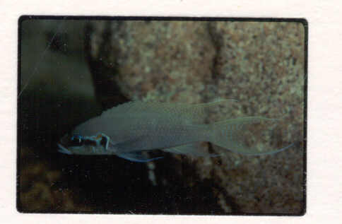
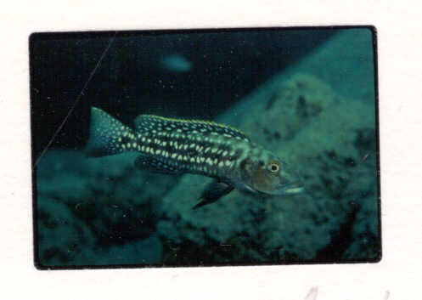
Lake Tanganyika have high biodiversity and endemism
LT - Cichlids > 250 sp. 97% endemic (Salzburger et al 2005)

Slide 5
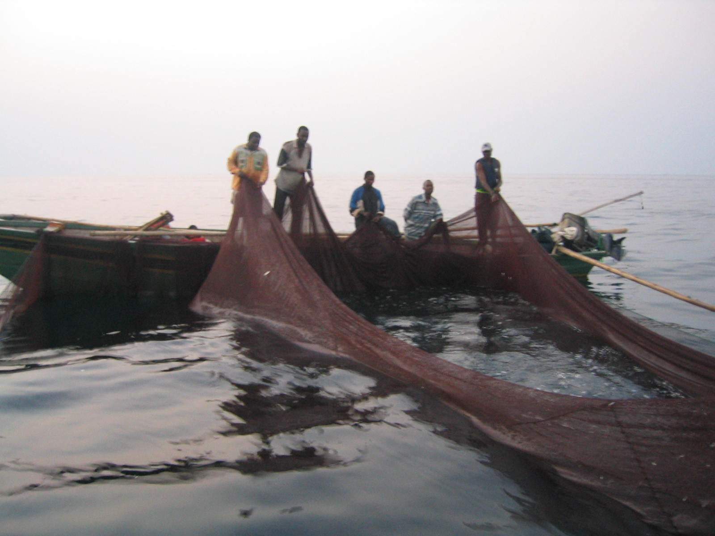
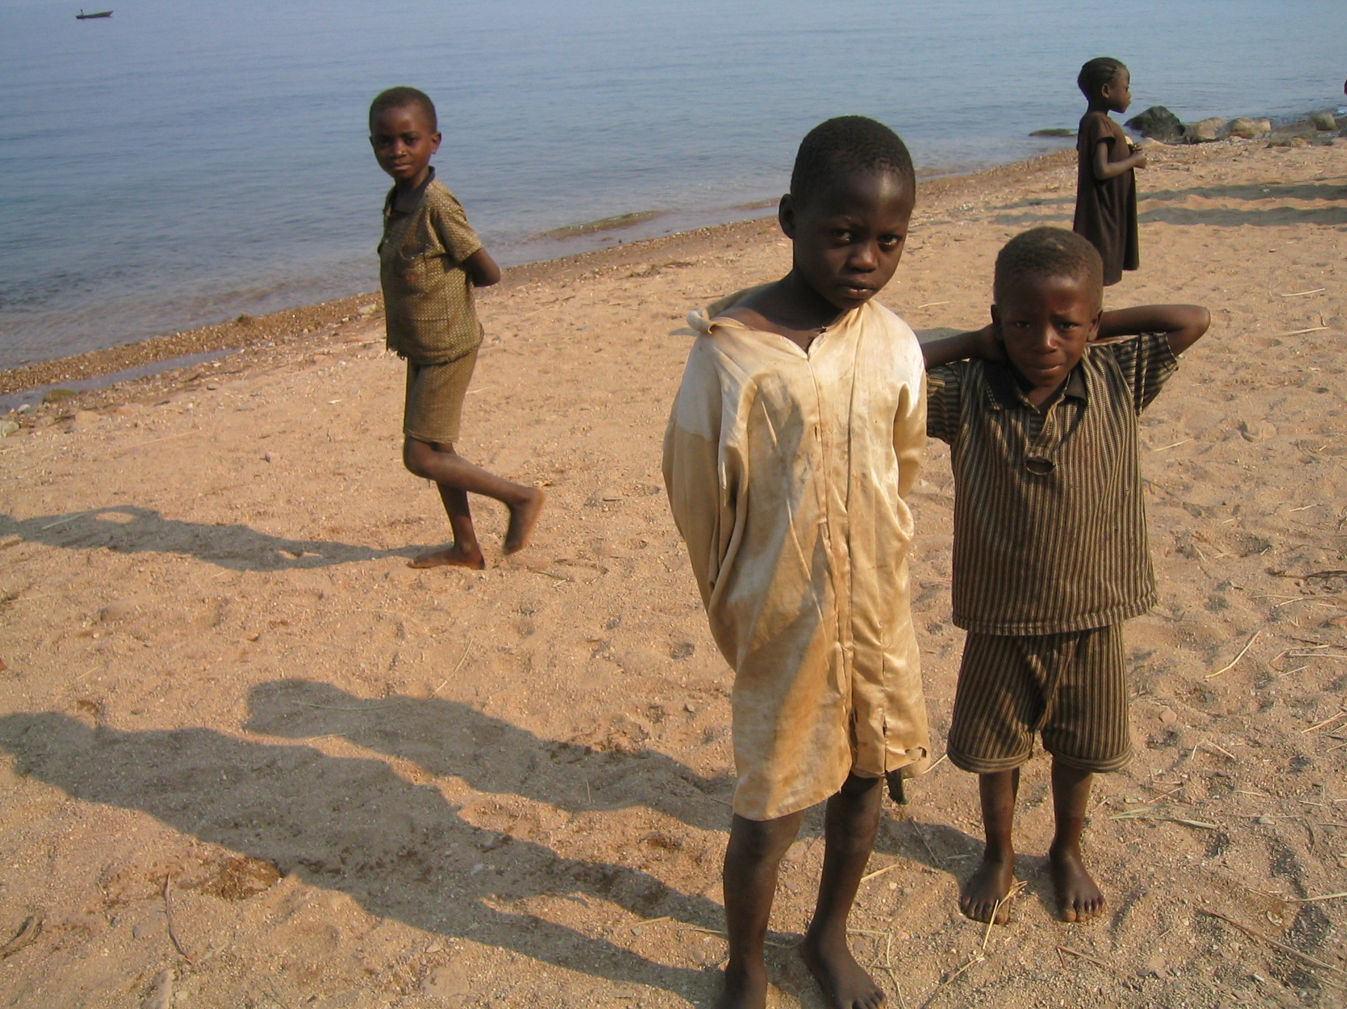
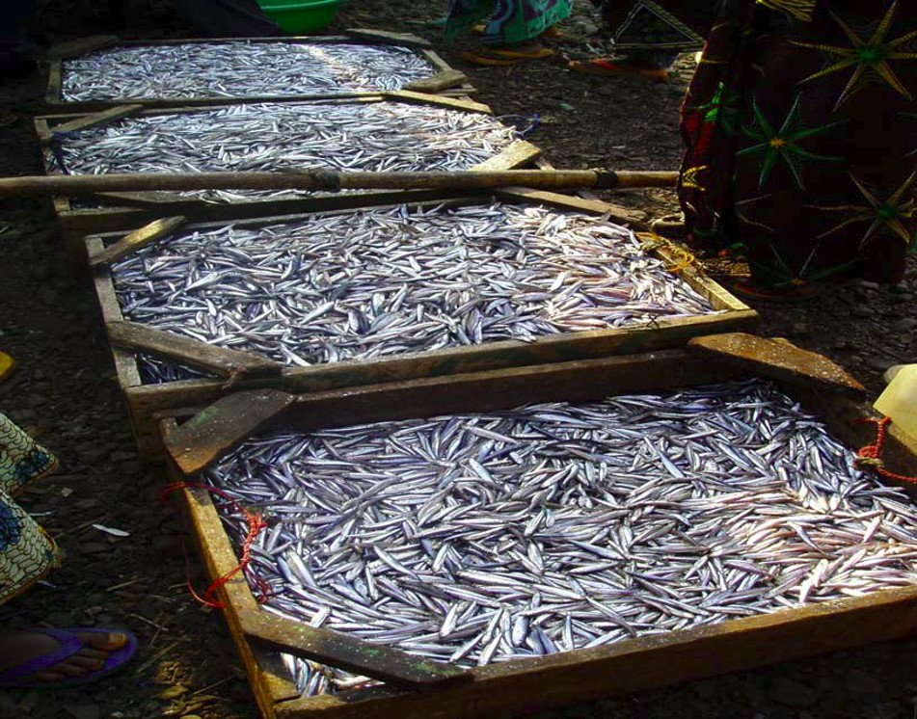
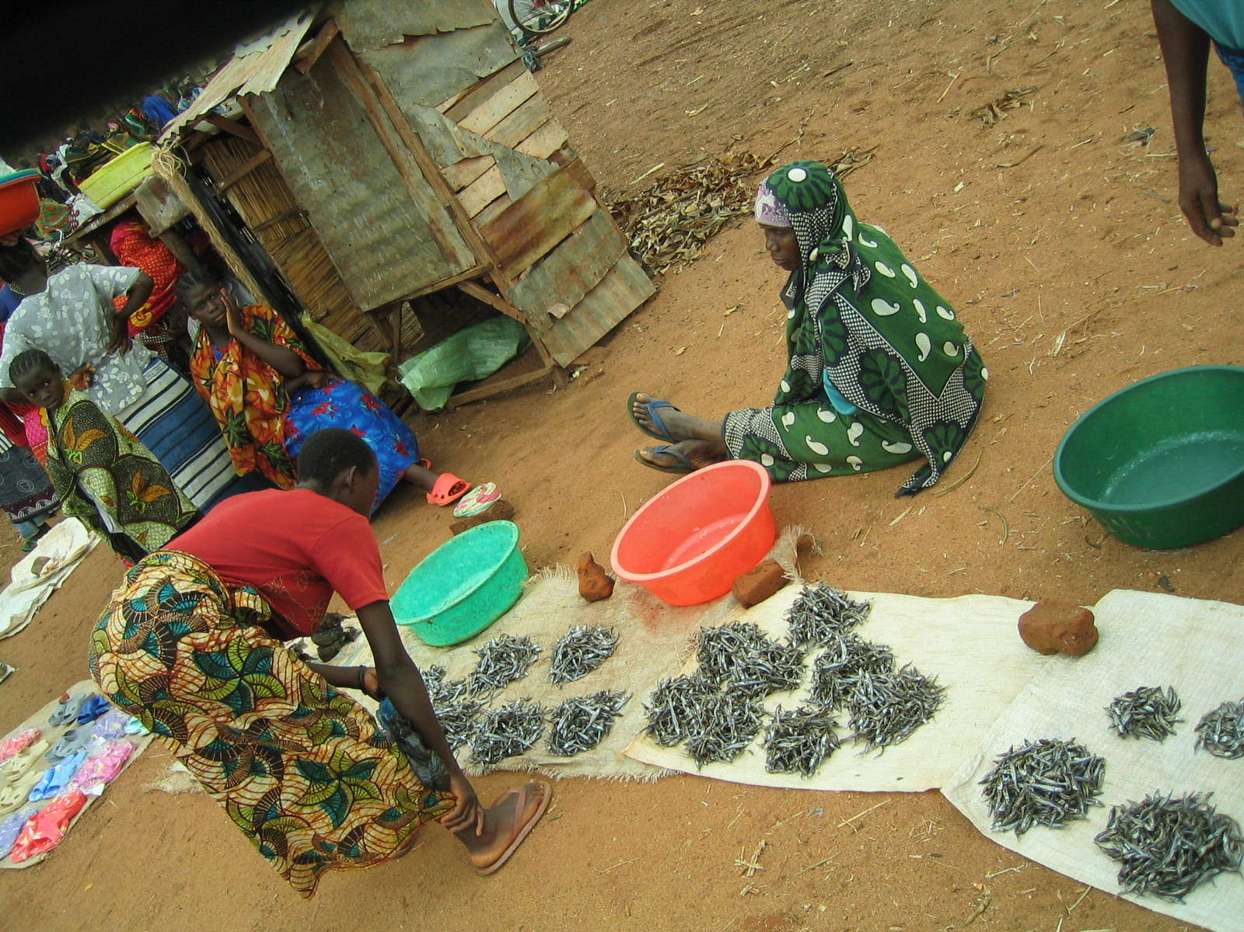
LT employs and feeds >10mil people
Photo credit: C.M. O’Reilly
Photo credit: IA Kimirei

Slide 6
Declining fishery resources
Source: Mgana et al. unpublished MS
Gap: stock data is very old.
Potential yield data is from 1994/95
We need to conduct stock assessment to inform policy and management

Slide 7
LT-SAG – Mission
Ensuring sustainability of Lake Tanganyika renewable natural resources and ecosystem services through collaboration in research, data synthesis and dissemination, education and outreach in order to support achieving the objectives of the Lake Tanganyika Convention (especially through the Strategic Action Plan (LTA – SAP))

Slide 8
Milestones - 2020
We conducted a survey to identify and prioritize issues for the lake
Conducted monthly virtual meetings – thanks to Zeph and ACARE
Identified stakeholders
Started drafting a review article where issues and research gaps will be discussed and possible interventions suggested. These will make our next steps into 2021

Slide 9
Top research priorities and lake issues
Land Use/Habitat Destruction
Fishery Health – Stock assessment is needed
Pollution
Biodiversity Decline
Climate Change
A long list of issues for the lake are listed here: https://www.agl-acare.org/lake-tanganyika

Slide 10
2021 and beyond
Finalize and publish a review paper to LT
Mobilize resources to harmonize research and data collection methods
Mobilize resources to conduct hydroacoustic survey to assess the fishery stocks of LT
Mobilize resources to equip key laboratories on the lake
Mobilize resources to monitor water quality and climate of LT
Integrate e-CAS in our fish and other data collections
Chart out needs for training

Slide 11
Asante/Thank you/Merci
www.agl-acare.org
Notes:
11

