Slide 1
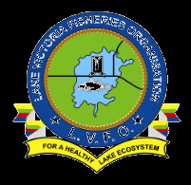
2020 Annual Conference of the African Great Lakes Stakeholders Network:
Lake Victoria Advisory Group
Name of presenter, position title and affiliation
Anthony Taabu –Munyaho et al.
Building the Foundation for Long-Term Scientific Inquiry and Networks
December 10th, Virtual
Notes:
1

Slide 2
PRESENTATION OUTLINE
Background (AG founding, membership and composition)
Leadership framework (leads, co-leads, etc)
Overview of the lake (geographical location, ecological potential and socio-economic potential)
advisory group purpose on the lake
Milestones: Highlights and successes of 2020
Top research priorities and lake issues
Roadmap (plans-2021 and beyond, opportunities)
Best resource investment for this lake/group
2
Notes:
2

Slide 3
Background
Under the auspices of The Nature Conservancy (TNC) The African Centre for Aquatic Research and Education (ACARE) convened an international network workshop for African Great Lakes in Entebbe Uganda in November 2019
The conference resolved to form African Great Lakes Specific Advisory Committees
Lake Victoria is one of the major AGLs where such a advisory committee was formed
Membership was constituted from key stakeholders in fisheries mainly from Academic institutions, Fisheries Competent Authorities, Research institutions, Regional Fisheries/Lakes management organizations (LVFO, LVBC)
LVAG management structure is as follows:
3

Slide 4
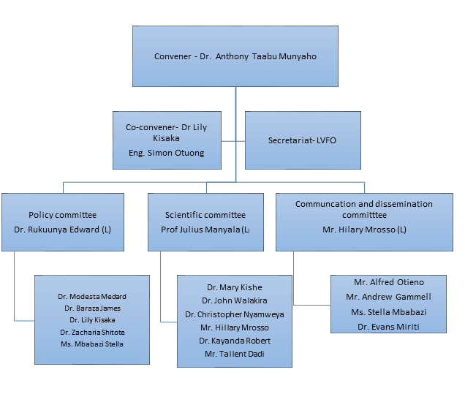
Lake Victoria AG Leadership
4

Slide 5
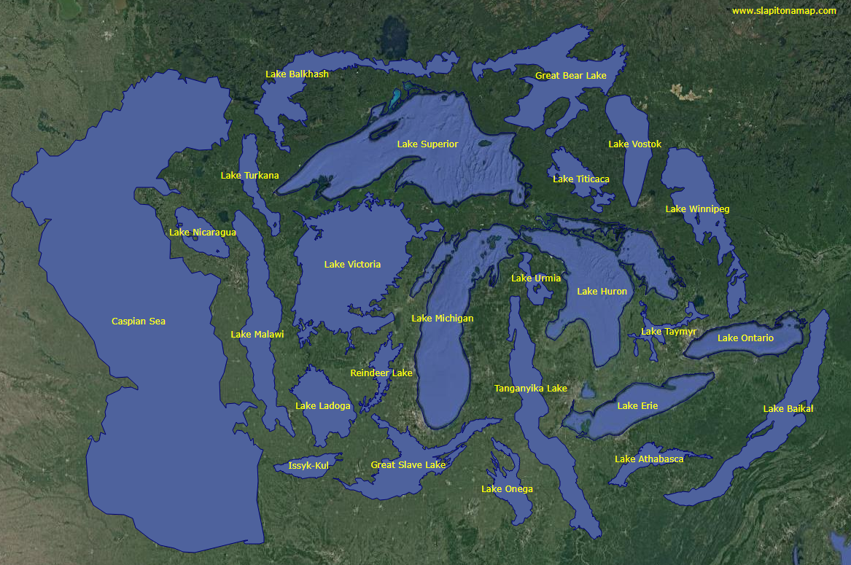
Overview of the Lake
5

Slide 6
Overview of the Lake
Lake Victoria is iconic in both its size and function.
Shared lake between Kenya (6%), Uganda (43%) and Tanzania (51%)
It is the largest tropical lake
Important source of inland fishery production; employment to local people, source of protein, supports national, regional and international trade
The lake’s ﬁsheries annual catch of close to 1 million tons accounts for about 1% and 8% of the world’s total and inland capture landings respectively (FAO, 2016)
6

Slide 7
Overview of the Lake
A chronology of significant events in Lake Victoria
7

Slide 8
Purpose of the advisory group on the Lake Victoria
a) Policy advice (Policy makers and resource managers)
Identify and submit research and information gaps
Receiving and synthesizing policy briefs
Engage/ interface with policy makers and managers
b) Scientific roles
Develop a harmonized research strategy on Lake Victoria
Synthesizes scientific information and production of periodic report
Advise and guide on producing guidelines and standard operating procedures
8

Slide 9
Purpose of the advisory group Cont'd
b. Scientific roles cont'd
Prepare research framework/ researchable proposals
Identify research gaps especially emerging issues
Analyze existing research agenda in the different research institutions
c. Communication and dissemination roles
Prepare policy briefs
Dissemination of scientific findings
d) Partnerships
Build partnership to mobilize resources to support activities of the group and key stakeholder engagements
9

Slide 10
LVAG Achievements in 2020
Despite COVID –19 situation and consequent restrictions, the LVAG made progress as follows:
Successfully held Periodic progress review with members virtually
Prepared progress reports and shared with ACARE and the LVFO (thanks to Zephania)
Supported the development of the draft MOU between LVFO and ACARE
Developed a draft working document to link the LVAG to the LVFO Stock Assessment Regional Working Group
In partnership with LVFO, University of Iceland and
10

Slide 11
TOP Research Priorities for LVAG
Monitoring the abundance, spatial and temporal distribution, biology, ecology of major fish species and their exploitation patterns
Co-management, user rights, community-based management and socio-economic trade-offs
Fish maws, harvesting methods, sizes in relation to the fish, the processing, marketing, and end products
Climate change and its impact on fisheries and aquaculture
Pollution and effects of increased algal blooms to human health
11

Slide 12
Roadmap (plans-2021 and beyond, opportunities)
Convene a technical working group meeting to work on Fish Maw Consultancy report and chat the way forward by January 2021
Linking up with relevant LVFO Regional Working Groups (RWGs) to develop proposals by March 2021
Present progress of the LVAG to FASCoM by April 2021
Link up with LVBC and University of Iceland to develop a project to address pollution and Climate change impacts on the lake by June 2021
12

Slide 13
Best Resource Investment for LVAG
Considering inadequacy in infrastructure, data and human resource, the following investments are desirable :
Developing research infrastructure and equipping specialized laboratories/ICT infrastructure for an all round aquatic research in Lake Victoria
Support to collect, compile and collate fisheries and environmental data
Capacity for remotely sensed environmental data to facilitate early warning systems and modelling of biophysical components
Spatial planning for utilization of Lake Victoria water space for fishery, cage culture, transportation and aesthetic values
Human capacity building to address multi-disciplinary and trans-boundary policies, management and conservation
13

Slide 14
Thank you
www.agl-acare.org
Notes:
14

