Slide 1



Enhancing Conservation and Sustainable Development of African Great Lakes Through Cross-Basin Collaboration:
A Blueprint
Colin Apse
The Nature Conservancy
Africa Regional Office
&
Richard Ogutu-Ohwayo
AFLANET-African Lakes Network

Slide 2
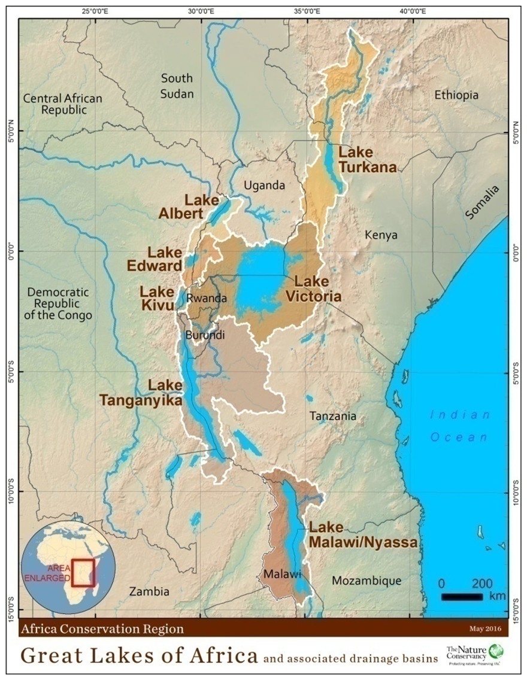
The African Great Lakes
The AGL consist of seven major lakes which are shared between 11 countries with each lake falling in >1 country
The lake have common values and face similar threats
The factors influencing the lakes are best addressed through cross basin collaboration

Slide 3
Interventions
TNC initiated a program in 2015 to develop a system to enhance CSD of AGL through cross-basin collaboration
It was a participatory process which involved organizing a conference of top officials and other stakeholders to work together in developing the system
The conceptual framework for achieving CSD of AGL is illustrated in the Figure.

Slide 4
Outputs
An AGLC organized and a collaborative network and coordination system developed;
Factors influencing CSD of AGL and priority interventions identified;
The governance systems examined;
Status and similarities of influencing factors and interventions on individual lakes determined;
Priority interventions piloted;
Information sharing platform established, and;
Sustainability plan proposed.

Slide 5
The Conference
An AGLC was organized to initiate development of a collaborative network and coordination system, and share information.
It involved top officials of RLMO (LVBC, LVFO, LTA, ABAKIR, NELSAP), government departments, and experts responsible for CSD of AGL.
Lakes Malawi/Nyassa/Niassa and Turkana with no RLMO were represented by top government officials responsible for CSD of AGL.
Other collaborators include NGOs, CBOs, Development partners, communities, and individuals.
These stakeholders were represented on COC and TC, and attended the AGLC.
The committees were coordinated by a Secretariat established by TNC.

Slide 6
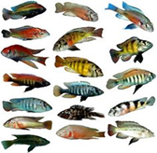
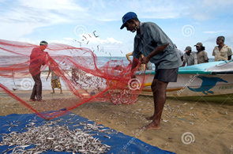
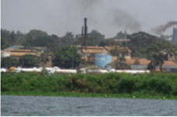
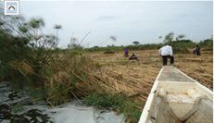
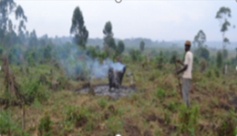
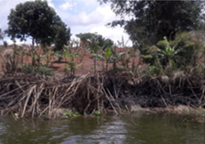
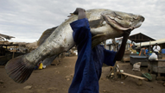

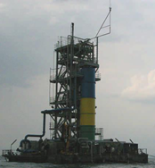
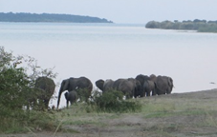
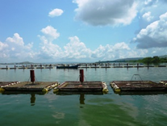
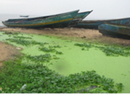
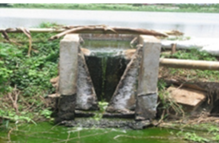
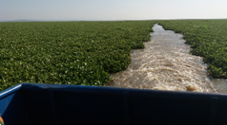
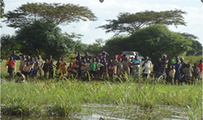
Influencing factors and priority
26 influencing factors and priority interventions were identified and adopted for implementation through a Conference Resolution. Summary discussion notes were prepared on each influencing factor.
Influencing factor | Interventions
Human population growth; | Control human population growth
Poverty and livelihood; | Diversifying fishery livelihoods
Water and sanitation; | Improve water and sanitation
Biodiversity loss; | Conserve aquatic biodiversity
Over-fishing; | Control fishing capacity
Fish species introductions; | Introduce only in impoverished waters
Emerging small pelagic fisheries; | Developing small pelagic fishes
Cage aquaculture; | Apply BMPs in cage aquaculture
Nutrient enrichment; | Control nutrient enrichment
Pollution; | Control pollution
Invasive weeds; | Control invasive weeds
Climate change; | Develop adaptation and mitigation measures
Land use change; | Promote SLM practices
Dams, Urbanization, Minerals, oil, and gas, Tourism; Navigation | Plan dams, urban areas, and mining, monitor and manage impacts
Policies | Update policies
Institution | Strengthen institutions
Funding | Develop sustainable funding
Information and data | Share information and data

Slide 7
Governance systems
National research and management institutions in riparian countries collect information and data, and propose interventions.
RLMO harmonize the interventions proposed by riparian countries.
Harmonized interventions are adapted by riparian countries and translated into policies which are applied at national level.
Development of policies is guided by those on the influencing factors at global, continental, and regional levels.

Slide 8
Status and similarities influencing factors on individual lakes
Influencing factor | Victoria | Malawi | Tanganyika | Kivu | Edward | Albert | Turkana
Demographic characteristics:
Human population growth;
Poverty and livelihoods;
Water and sanitation;
Fishes and fisheries:
Biodiversity loss;
Over-fishing;
Fish species introductions;
Small pelagic fisheries;
Cage aquaculture;
The lake habitats:
Nutrient enrichment;
Pollution;
Invasive weeds;
Climate change;
Basin factors;
Land use change;
Dams;
Urbanization;
Minerals, oil, and gas;
Tourism;
Navigation;
Governance systems:
Policies;
Institutions;
Funding;
Information and data sharing
Many of the influencing factors are common between lakes and are best addressed across basins.
Summaries of influencing factors and interventions have been prepared for each lake to guide management
[Red = High; Yellow = Medium; Green = Low]

Slide 9
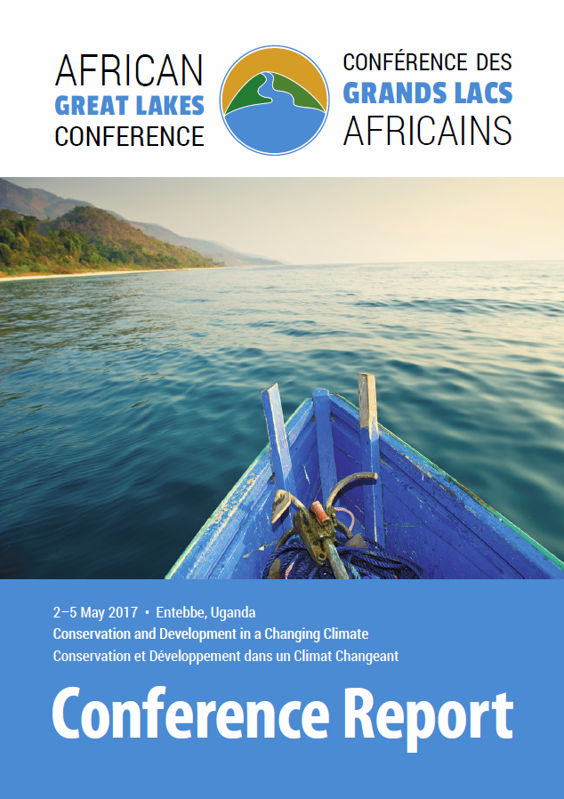
African Great Lakes Conservation Fund
With support from the John D. and Catherine T. MacArthur Foundation
Five of the 26 African Great Lakes Conference priority interventions were piloted to demonstrate cross-basin collaboration:
(1) Designing and maintaining the AGLI platform;
(2) Developing and promoting a network of AGL stakeholders;
(3) Developing and promoting BMPs in cage aquaculture;
(4) Building resilience of local communities to climate change, and;
(5) Development and application of electronic fish catch assessment

Slide 10



Improving and maintaining an information sharing platform
African Great Lakes Information Platform- transferred to U. of Nairobi from TNC & updated, including:
Summaries of influencing factors and priority interventions;
Lake summaries;
Pilot interventions;
Provision for stakeholders to contribute content, and;
Provides for linkage to other sources of information.
www.africangreatlakesinform.org

Slide 11
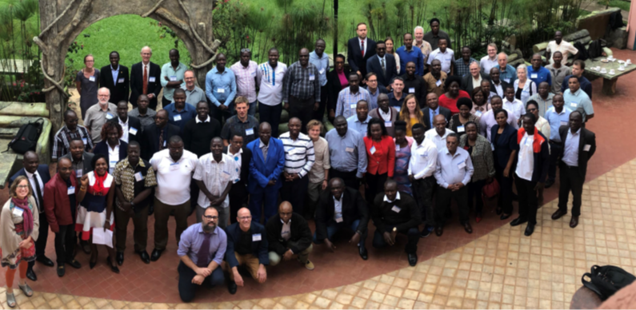
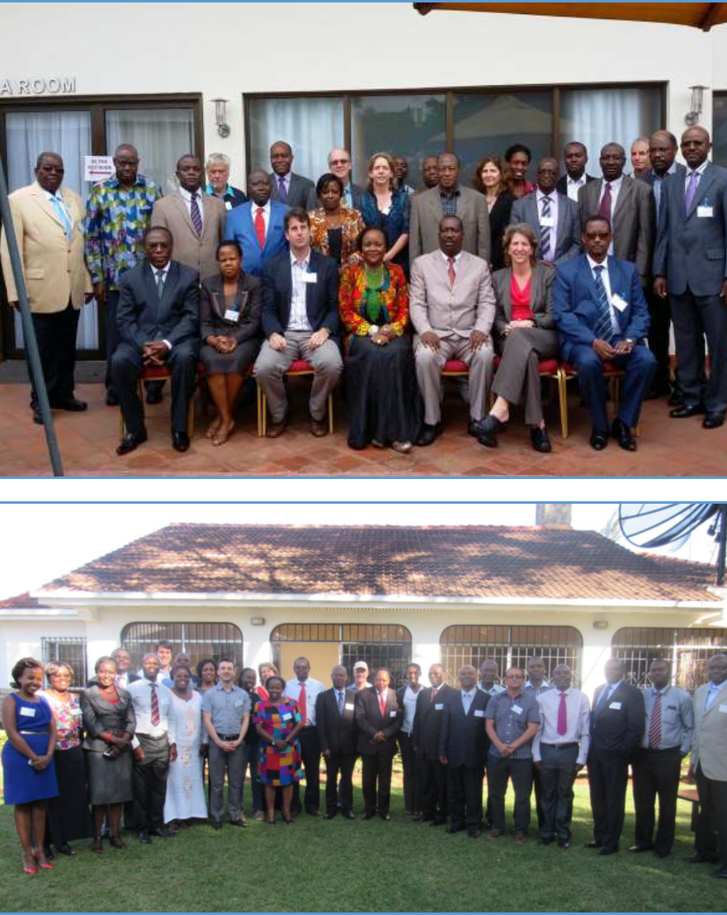
Developing and promoting a network of stakeholders
Networking of RLMO and partners initiated through the AGL Conference process
7 Lake Advisory Groups were formed through ACARE;
Partnerships between AGL and other NA Great Lakes initiated.

Slide 12
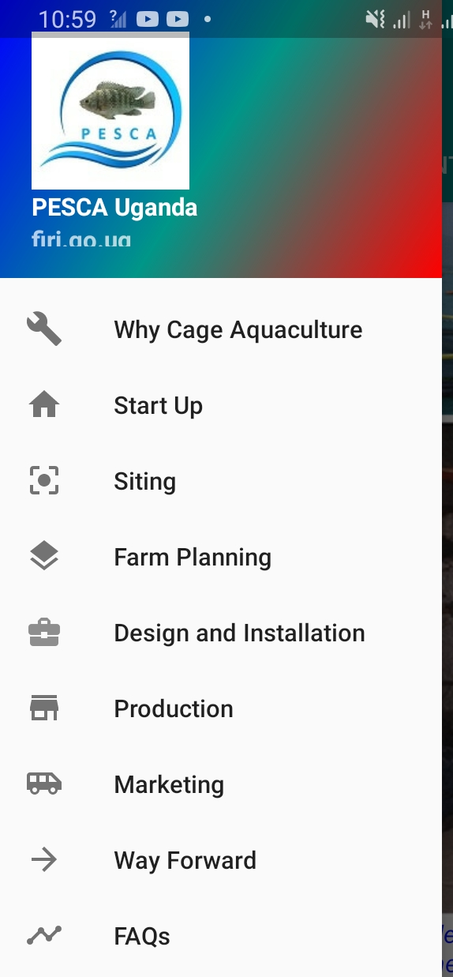
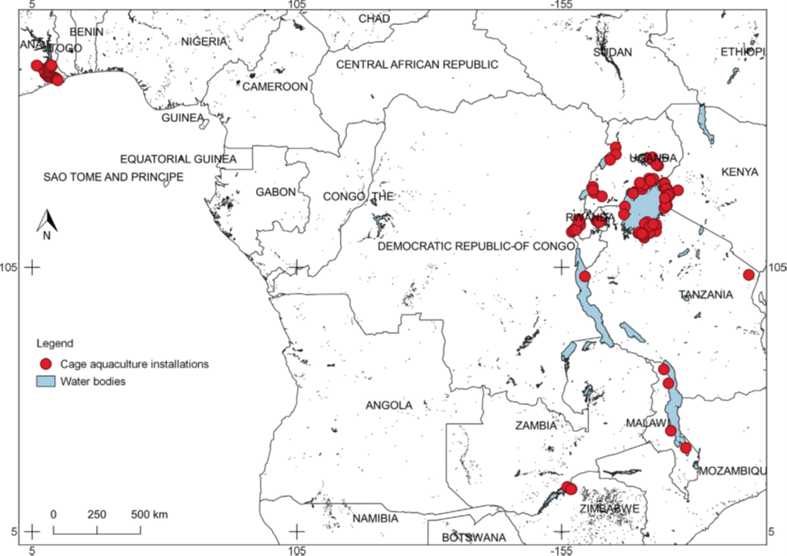
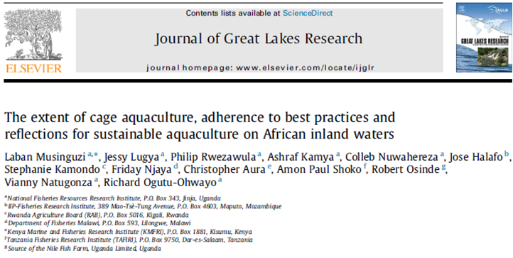
Developing and promoting BMPs in cage aquaculture
African Great Lakes Cage Aquaculture Network (AGL-CAN) was established in 5 AGL basins, 6 AGLR countries, with 7 national institutions
The distribution of cage aquaculture in AGL and Africa was determined & published in the Journal of Great Lakes Research
A mobile application and other outreach materials on BMPs were produced.
The mobile application “NARO cage aquaculture” can be accessed on Google play store. The application outlines the main steps of BMP in cage aquaculture.

Slide 13
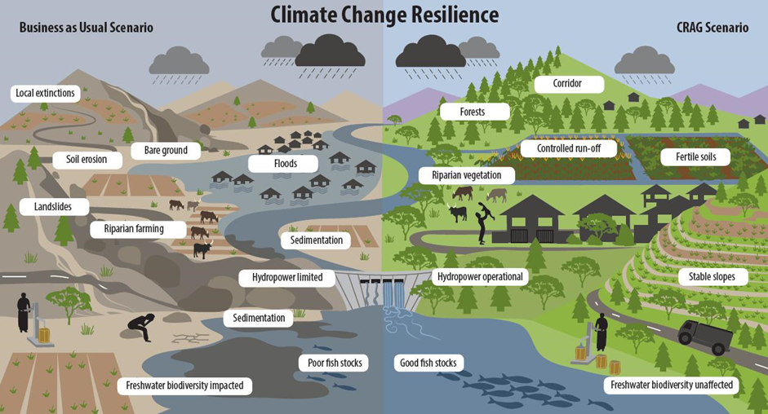
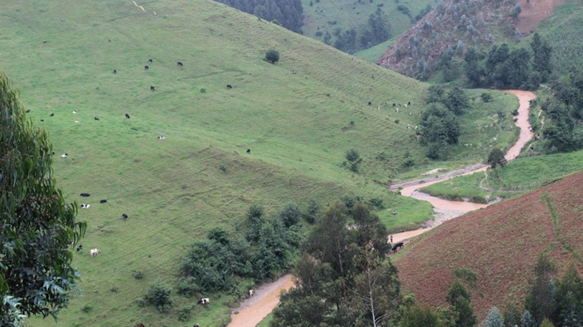
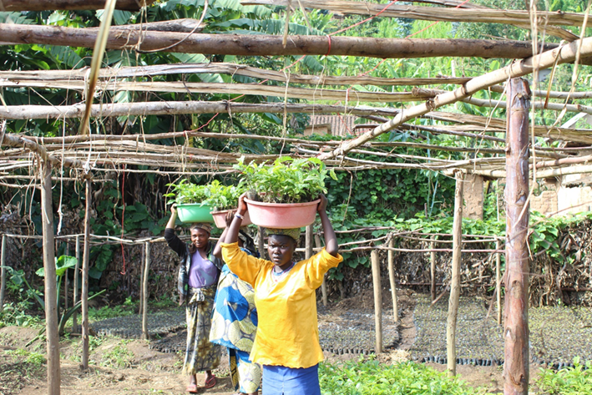
BirdLife International:
Building resilience of local communities to climate change
Sediment fingerprinting was used to identify erosion hotspots;
Vulnerability assessments were undertaken with communities to identify adaptation needs of the communities and requisite interventions;
Over 1.5 million seedlings were planted by communities, on ~340 hectares and involving 6,700 households to reduce soil erosion.
70-90% of the trees planted survived
The technique can be replicated across lake basins

Slide 14
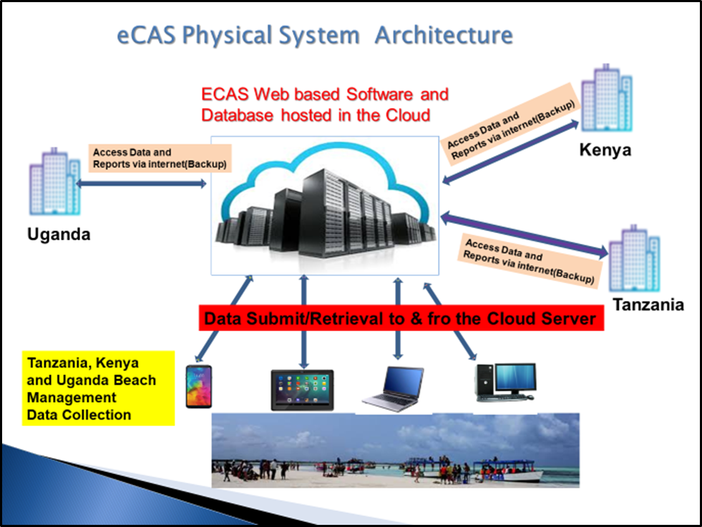
Electronic Fish Catch Assessment (TAFIRI-led)
e-CAS collects data at fish landings using mobile phones
sends it to a central storage hosted in the Cloud
picked for analysis at different levels of research and administration
Highlights:
Further development of software system
Tanzania Mainland has adopted eCAS as the National Fisheries Information Platform (FIP)
Support from GIZ allowed for capacity in e-CAS was enhanced through training of 299 users across lakes Tanganyika & Victoria
e-CAS continues to be developed and tested on Lake Tanganyika in partnership with TNC

Slide 15
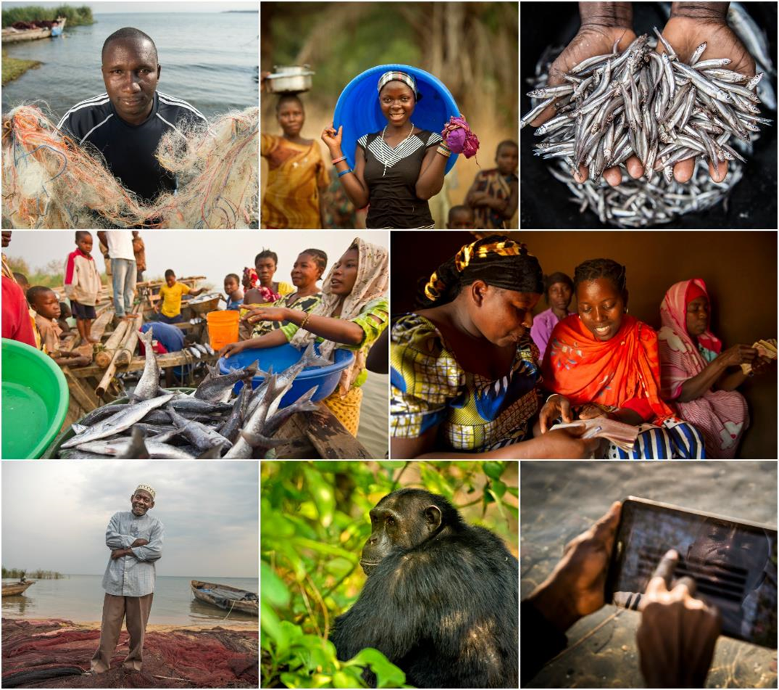

Africa Great Lakes Coordination: Long-term Sustainability
TNC AGL is closing out - focus on Lake Tanganyika basin wide.
AFLANET and TNC recommend:
  Given AGLCF has proved valuable – promote results (see paper), look for funders to extend joint priorities
  Increase engagement with ACARE and AFLANET
  Content contributions to AGL Information Platform
  Increased coordination across the regional lake management organization and the national institutions
  Future African Great Lakes Conferences (SIAL9-Kigoma)
  Together we can more efficiently and effectively address AGL challenges going forward

